Slide 1
Ambulatory ECG Monitoring: From Holter to Wearables
Choosing the Best Solution for Your Patient
Notes:
No speaker notes/FC needed on this slide
(Slide provided by client)

Slide 2
AGENDA
History and background​
Prescribable monitors​
  Retrospective monitors​
  During-Wear Transmission monitors​
Implantable Loop Recorders​
Consumer wearables​

Slide 3
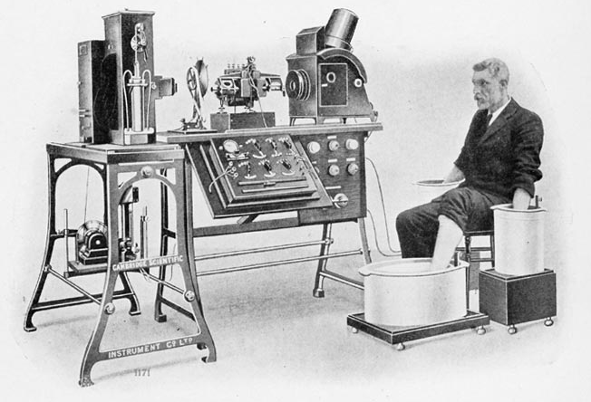
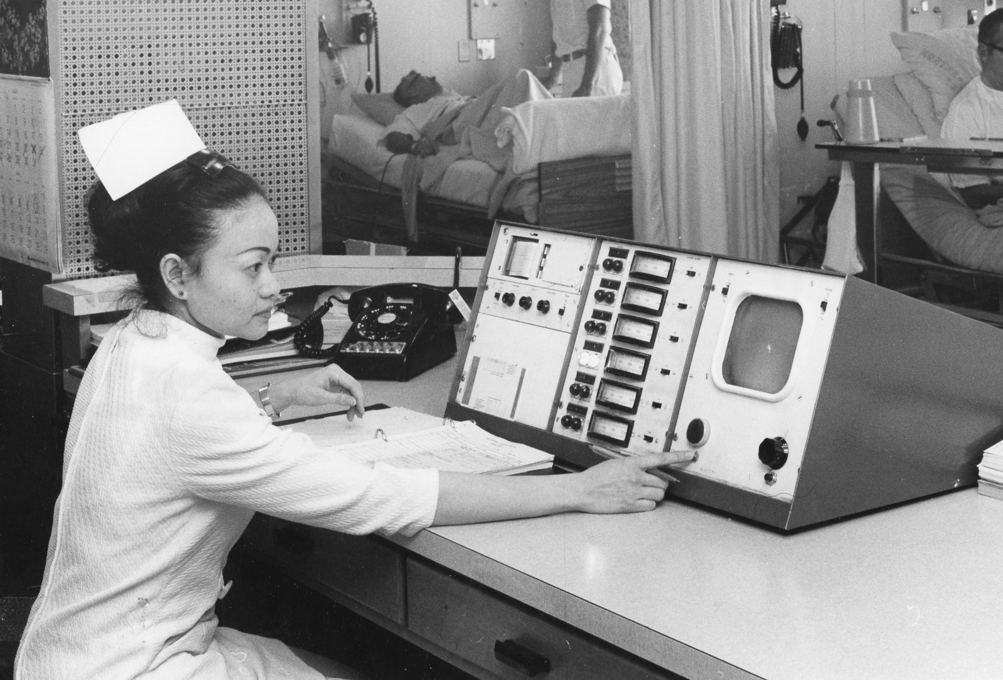
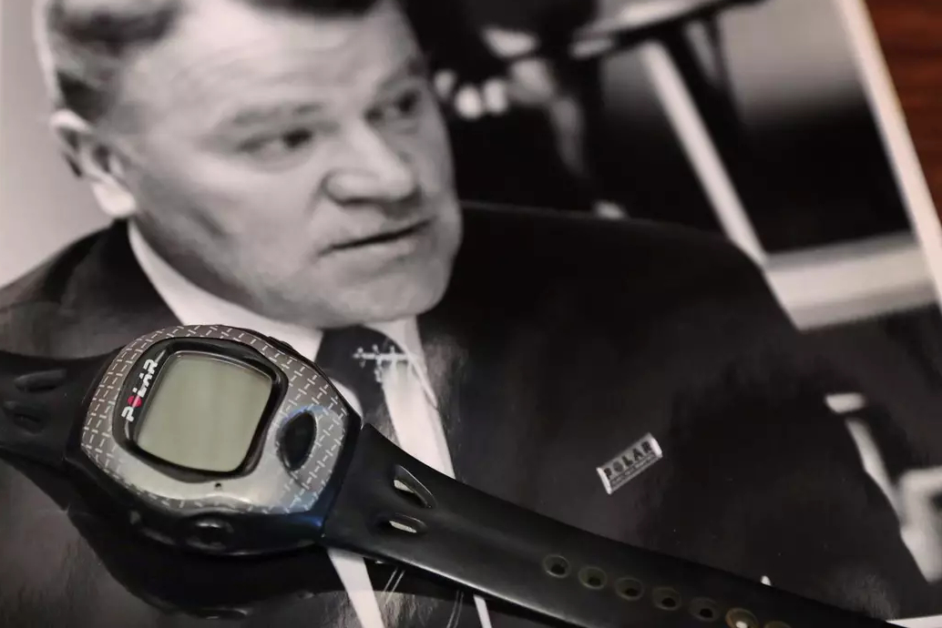
Brief History of Cardiac Monitoring
1895
1960s
1977
First ECG machine
First cardiac care units
First wearable watch technology

Slide 4
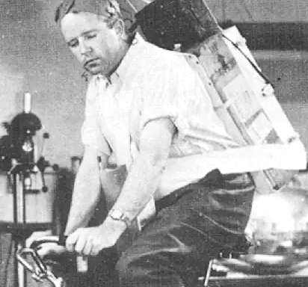
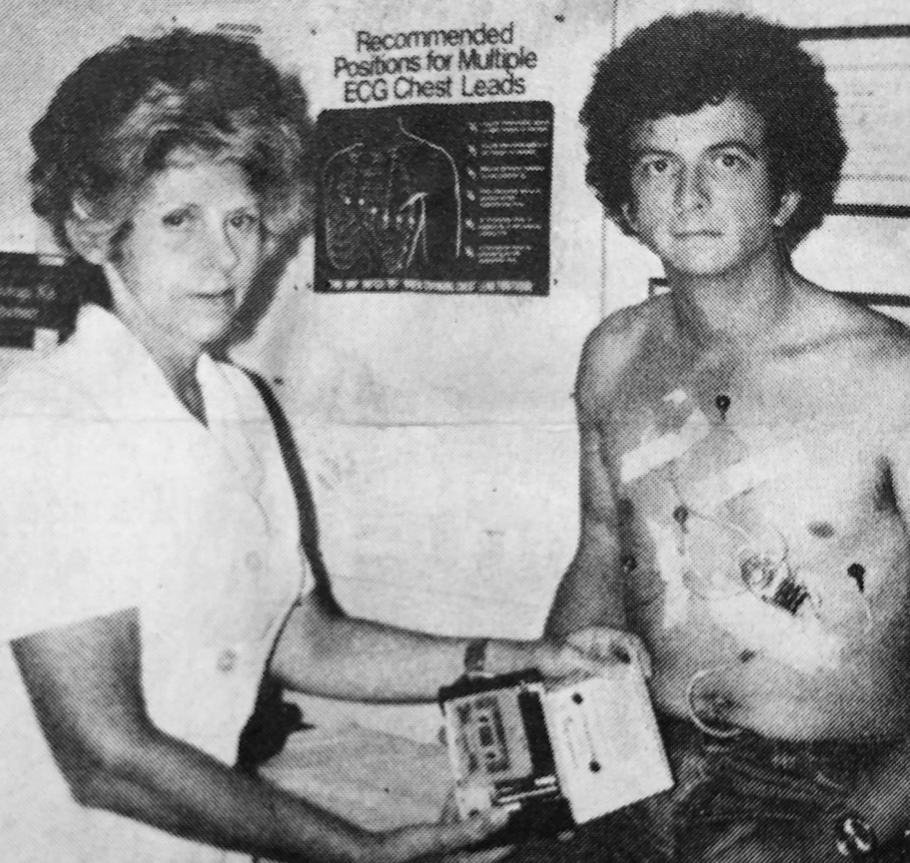
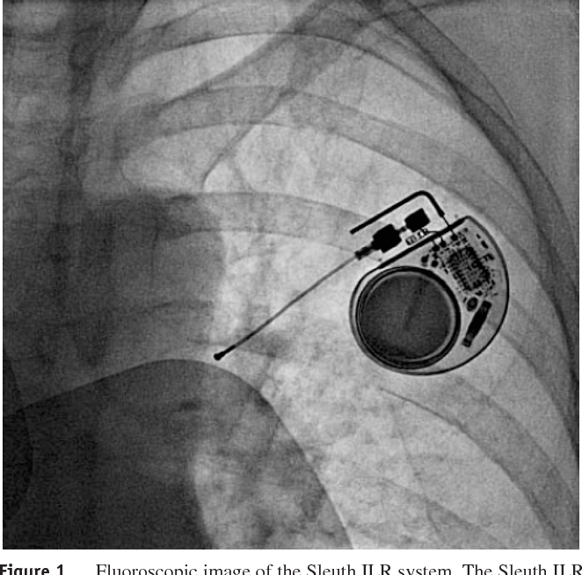
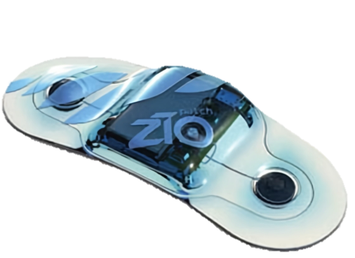
Brief History of Wearable Cardiac Monitoring
1947
1965
1990
2011
First Holter monitor
First wired portable monitors
First implantable monitors
First wearable patch monitors

Slide 5

The Staggering Burden Associated with Arrhythmias and Palpitations
1 in 3
16%
$26B
460K
684K
people are diagnosed with AF in their lifetime
of PCP visits are due to palpitations
Annual cost of AF to the US healthcare system
hospitalizations annually due to arrhythmia
emergency department visits per year
Weng LC, Preis SR, Hulme OL, et al. Genetic predisposition, clinical risk factor burden, and lifetime risk of atrial fibrillation. Circulation. 2018;137(10):1027-1038. doi:10.1161/circulationaha.117.031431
Wexler, R. K., Pleister, A., & Raman, S. V. (2017, December 15). Palpitations: evaluation in the primary care setting. AAFP.
Lippi G, Sanchis-Gomar F, Cervellin G. Global epidemiology of atrial fibrillation: An increasing epidemic and public health challenge. International Journal of Stroke. 2020;16(2):217-221. doi:10.1177/1747493019897870
Bhonsale, A., (2024). Mortality, Hospitalization, and Cardiac Interventions in Patients With Atrial Fibrillation Aged <65 Years. Circulation. Arrhythmia and Electrophysiology, 17(5).
Probst MA, Mower WR, Kanzaria HK, Hoffman JR, Buch EF, Sun BC. Analysis of Emergency Department Visits for Palpitations (from the National Hospital Ambulatory Medical Care Survey). The American Journal of Cardiology. 2014;113(10):1685-1690. doi:10.1016/j.amjcard.2014.02.020

Slide 6
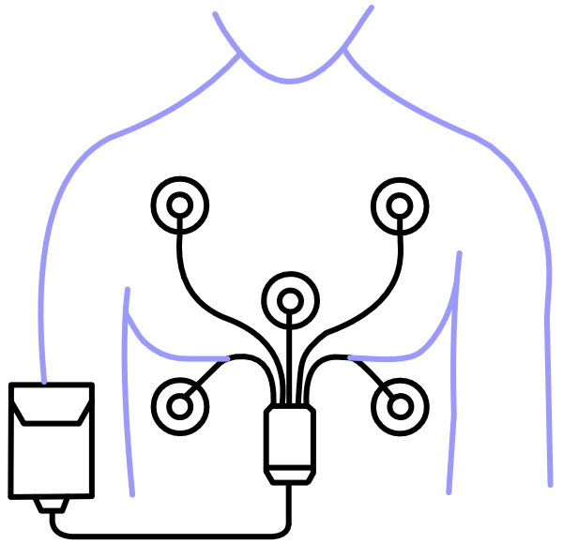
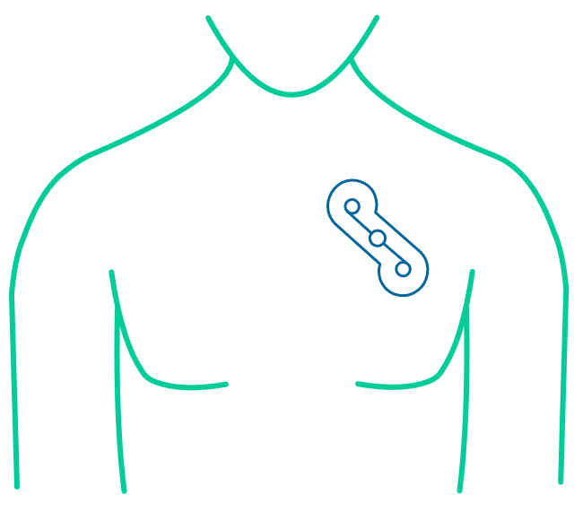
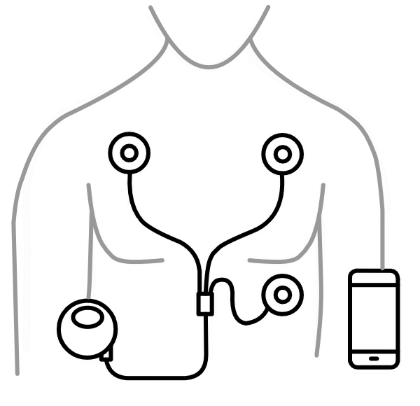
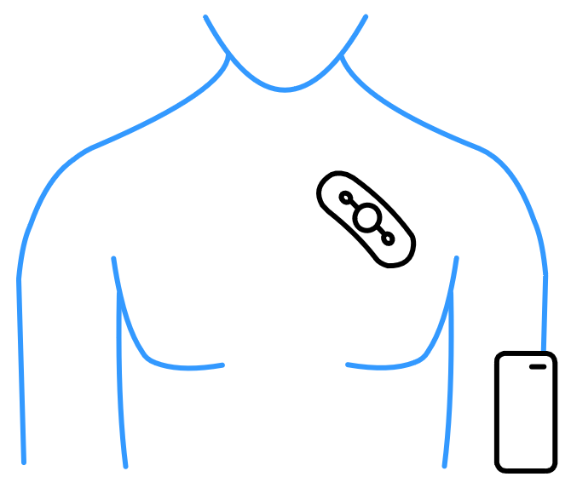
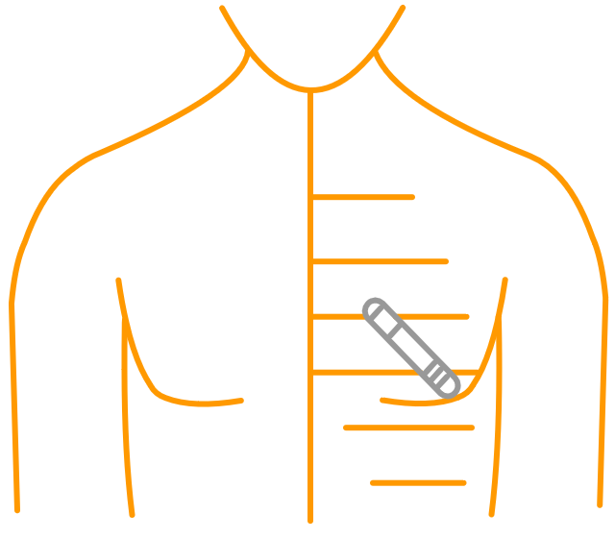
Prescribable ECG Monitors
RETROSPECTIVE MONITORS
DURING WEAR TRANSMISSION MONITORS
 | Holter Monitor | Long-Term Continuous Monitor | Event Recorder | Mobile Cardiac Telemetry | Implantable Loop Recorder
Monitoring Time | 24–48 hours | 3–15 days | Up to 30 days | Up to 30 days | 6 years +
Recording Type | Continuous | Continuous | Episodic | Episodic or Continuous | Episodic and Burdens
Form Factor | Lead Based* | Patch Based | Lead Based* | Patch Based* | Implantable
*Varies by Manufacturer
Spatz ES, Ginsburg GS, Rumsfeld JS, Turakhia MP. Wearable digital health technologies for monitoring in cardiovascular medicine. New England Journal of Medicine. 2024;390(4):346-356. doi:10.1056/nejmra2301903

Slide 7
Centers for Medicare & Medicaid Services Coverage Determination
Consideration 1: Symptoms
  Palpitations
  Syncope
  Chest Pain
  Dyspnea
  Dizziness
Consideration 2: Use Cases
  Initiate, revise or discontinue drug therapy
  Evaluate ischemic heart disease
  Evaluate MI survivors
  Assess coronary artery disease
RETROSPECTIVE MONITORS
DURING WEAR TRANSMISSION MONITORS
Consideration 3:
Duration Needed?
Up to 15 days
Up to 30 days
Consideration 4:
Clinical Intervention?
Not likely during
wear time
Likely during
wear time
US Centers of Medicare and Medicaid Services. LCD - Electrocardiographic (EKG or ECG) monitoring (Holter or Real-Time Monitoring) (L34636). Published October 2023. Accessed March 11, 2025. https://www.cms.gov/medicare-coverage-database/view/lcd.aspx?lcdId=34636&ver=36

Slide 8




Ambulatory Cardiac Monitoring (ACM) Guidelines
Several organization guidelines have recommended the use of ACM
  Speaker please select your more impactful guidelines and add them here
  Refer to the guidelines bibliography page for more information

Slide 9


Ambulatory Cardiac Monitoring (ACM) in Patient Care
ACM use helps improve patient care and healthcare utilization
“Accurate and timely diagnosis of arrhythmias is crucial to direct therapies that can make an important impact on patient care and healthcare utilization.”
—ISHNE —HRS
Steinberg JS, Varma N, Cygankiewicz I, et al. 2017 ISHNE-HRS expert consensus statement on ambulatory ECG and external cardiac monitoring/telemetry. Heart Rhythm. 2017;14(7):e55-e96. doi:10.1016/j.hrthm.2017.03.038

Slide 10
Orientation to Modalities Scale
Quick review of ECG data
  Symptom Frequency and Monitoring Duration are inversely related
  As symptoms are more frequent, less monitoring duration is needed to understand the clinical picture
DATA URGENCY
High Symptom Frequency
=
Less Monitoring Duration
Low Symptom Frequency
=
More Monitoring Duration
Indicator
Non-urgent ECG review
Indicator
SYMPTOM FREQUENCY
MONITORING DURATION
Disclaimer: Ambulatory monitoring devices are intended for use in routine, non-acute settings and are not designed for high-risk patients or those requiring continuous, intensive care.

Slide 11
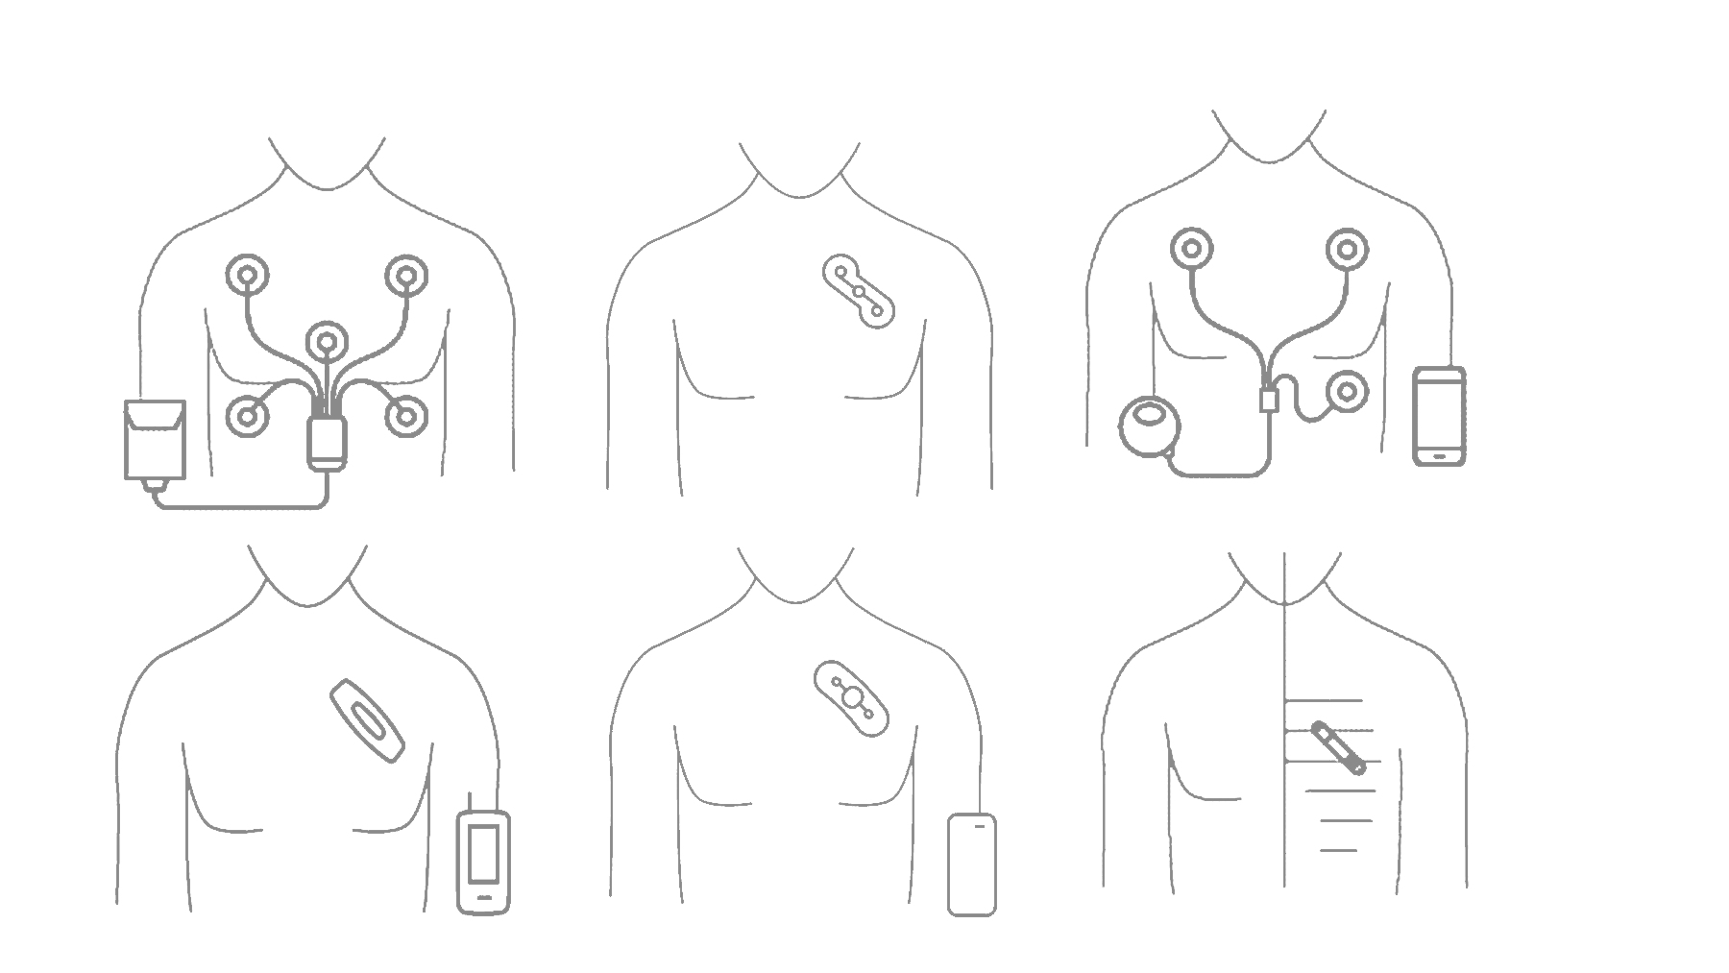
Monitoring Modalities
Mobile Cardiac
Telemetry
Implantable Loop Recorder
DURING WEAR
MONITORING
DATA URGENCY
Long-Term Continuous
Monitor
Event Recorder
RETROSPECTIVE
MONITORING
Wearables
Holter Monitor
SYMPTOM FREQUENCY
MONITORING DURATION
Disclaimer: Ambulatory monitoring devices are intended for use in routine, non-acute settings and are not designed for high-risk patients or those requiring continuous, intensive care.

Slide 12

Retrospective Monitors

Slide 13
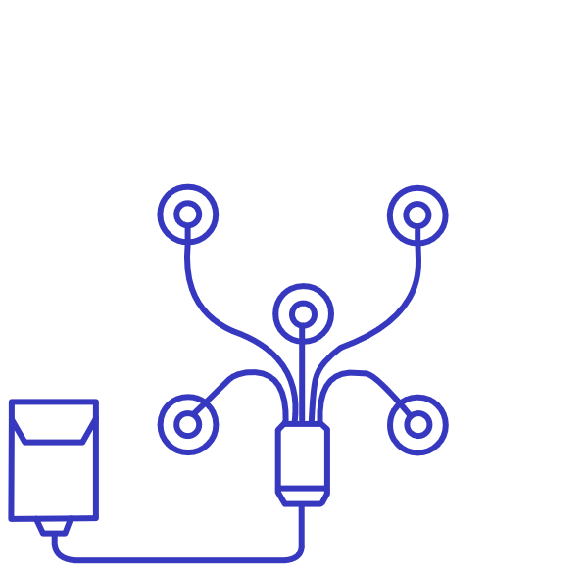
Holter Monitors
1985

Slide 14
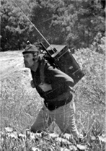
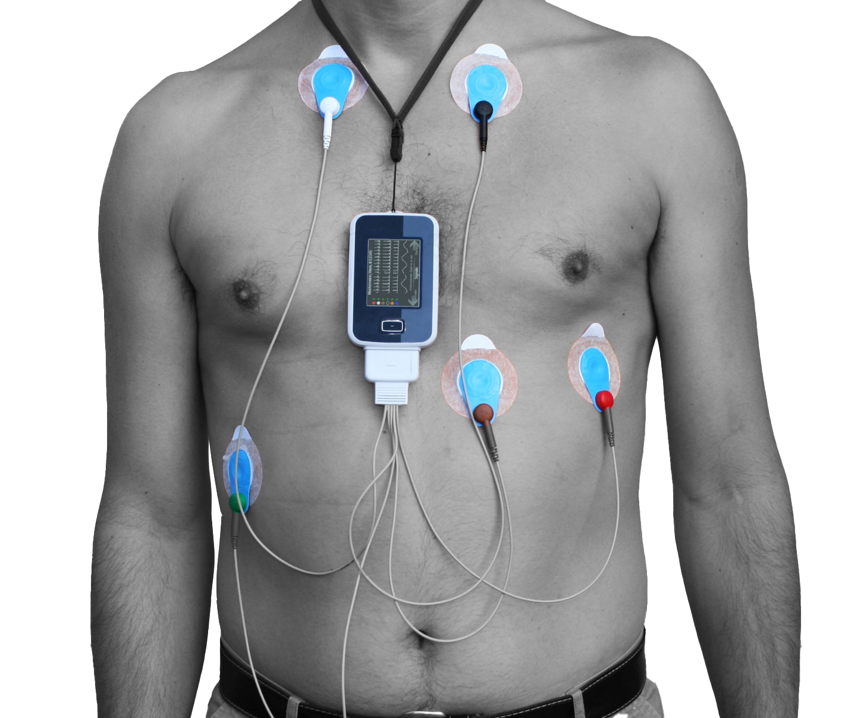

HOLTER MONITORS
How They Work
  Nurse places multiple-lead Holter and battery pack in clinic*
  Continuous: Device records ECG data continuously for 24-48 hours
  Patient returns Holter
  Staff (with software) interprets data and curates the final report*
    NOTE: Requires patient to remove device
    to shower
1947
Norman Holter
85 lbs. of equipment
Today
Traditional Holter Monitor
Photo credit: Kennedy HL. The history, science, and innovation of Holter Technology. Annals of Noninvasive Electrocardiology. 2006;11(1):85-94. doi:10.1111/j.1542-474x.2006.00067.x
*Varies by Manufacturer

Slide 15
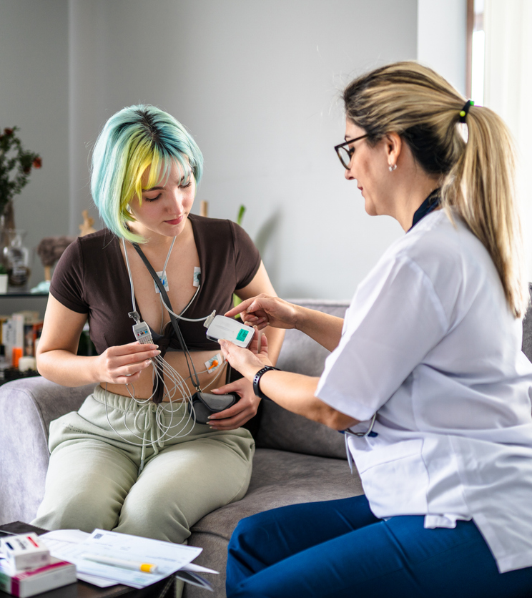

HOLTER MONITORS
Data Outputs
  Beat-to-beat ECG recording
  Heart rate trends*
  Repolarization changes (ST/T-waves)*
    Note: Staff interprets the data outputs
*Varies by Manufacturer

Slide 16
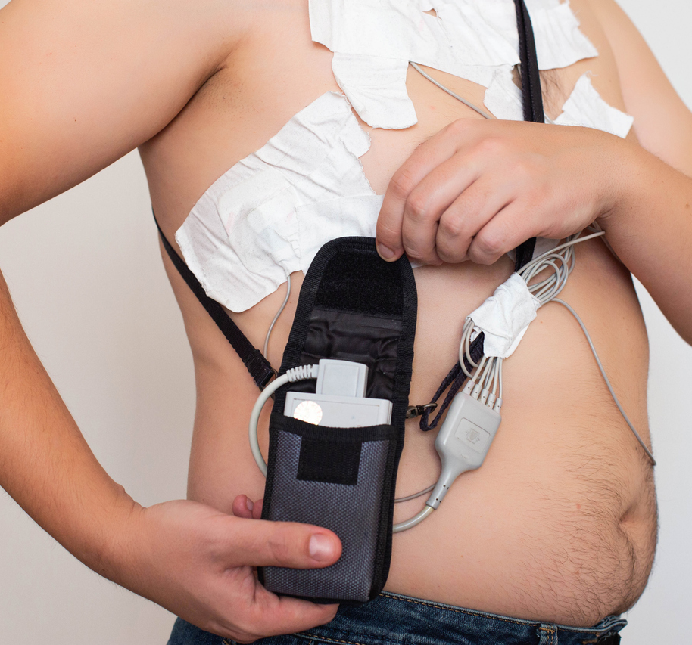

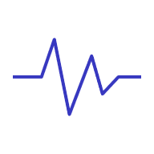

HOLTER MONITORS
Limitations of Holter Data
Short recording duration
Patient discomfort
Poor signal quality
Increased staff burden
Lead changes = data loss
Reynolds MR, et al. (2023). Comparative effectiveness and healthcare utilization for ambulatory cardiac monitoring strategies in Medicare beneficiaries. American Heart Journal, 269, 25–34.

Slide 17
Limitations of Holter Data
HOLTER MONITORS
ESTIMATED DIAGNOSTIC YIELD OF DIFFERENT ECG RECORDING MODALITIES
 | Event Recorder <60” | Standard Holter 24–48 Hours | Patch/Vest/Belt Recorders/MCT/ELR
 |  |  | 3–7 Days | 1–4 Weeks
Palpitations | 40–60% | 10–15% | 50–70% | 70–85%
Syncope | 6% | 1–5% | 5–10% | 15–25%
Low
diagnostic yield
High
retest rate
Asteggiano MB. ECG portable devices: example of e-Health strength and threats. https://www.escardio.org/Journals/E-Journal-of-Cardiology-Practice/Volume-18/ecg-portable-devices-example-of-e-health-strength-and-threats

Slide 18
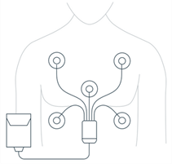
When to Consider a Holter
HOLTER MONITORS
  When symptoms are:
    Frequently occurring symptoms/
    arrhythmias (at least daily)
    Non urgent
  When patients:
    Are compliant
    Are capable of replacing leads
    Need brief monitoring for clinical decision making
DATA URGENCY
Holter Monitor
SYMPTOM FREQUENCY
MONITORING DURATION
Disclaimer: Ambulatory monitoring devices are intended for use in routine, non-acute settings and are not designed for high-risk patients or those requiring continuous, intensive care.

Slide 19
When to Consider a Holter
HOLTER MONITORS
Mobile Cardiac
Telemetry
DURING WEAR
MONITORING
DATA URGENCY
Implantable Loop Recorder
Long-Term Continuous
Monitor
Event Recorder
RETROSPECTIVE
MONITORING
Wearables
Holter Monitor
SYMPTOM FREQUENCY
MONITORING DURATION
Disclaimer: Ambulatory monitoring devices are intended for use in routine, non-acute settings and are not designed for high-risk patients or those requiring continuous, intensive care.

Slide 20

Long-Term Continuous Monitors (LTCM)
2011

Slide 21


LONG-TERM CONTINUOUS MONITORS (LTCM)
How They Work
  Single-lead patch placed in clinic or at home
  Continuous: Device records beat-to-beat heart data for 2-15 days*
  Symptomatic: ECG recorded upon symptom trigger
    Symptoms recorded in paper diary or app
  Asymptomatic: Auto-trigger for preset thresholds
  Patient returns device via mail*
    Benefits: High compliance rate, easy to place, often water-resistant*
*Varies by Manufacturer

Slide 22


LONG-TERM CONTINUOUS MONITORS (LTCM)
Data Outputs
  Independent Diagnostic Testing Facility (IDTF) downloads data and curates the report*
  AI analyzes ECG data on a beat-to-beat basis and identifies arrhythmias*
  Qualified Cardiac Technicians review ECG data before sending to clinician*
  Final report includes Symptomatic Events, Arrhythmias, Burdens, HR trends, PVC by unique morphology, PVCs by hour*
    Limitation: Patient diary symptom times are approximations, no alerts during wear, some require patch/battery changes*
*Varies by Manufacturer
*Varies by Manufacturer

Slide 23
Study | Comparison of LTCM vs Holter
LONG-TERM CONTINUOUS MONITORS (LTCM)
RESULTS | LTCM | HOLTER
Wear Time | 11.1 Days | 1.0 Days
Definitive Diagnosis* | 90% of the time | 64% of the time
Patient Preference | 81% preferred LTCM
Arrhythmias Detected | ↑ 57%
*based on Physician feedback
Barrett PM, Komatireddy R, Haaser S, et al. Comparison of 24-hour Holter Monitoring with 14-day Novel Adhesive Patch Electrocardiographic Monitoring. The American Journal of Medicine. 2013;127(1):95.e11-95.e17. doi:10.1016/j.amjmed.2013.10.003

Slide 24
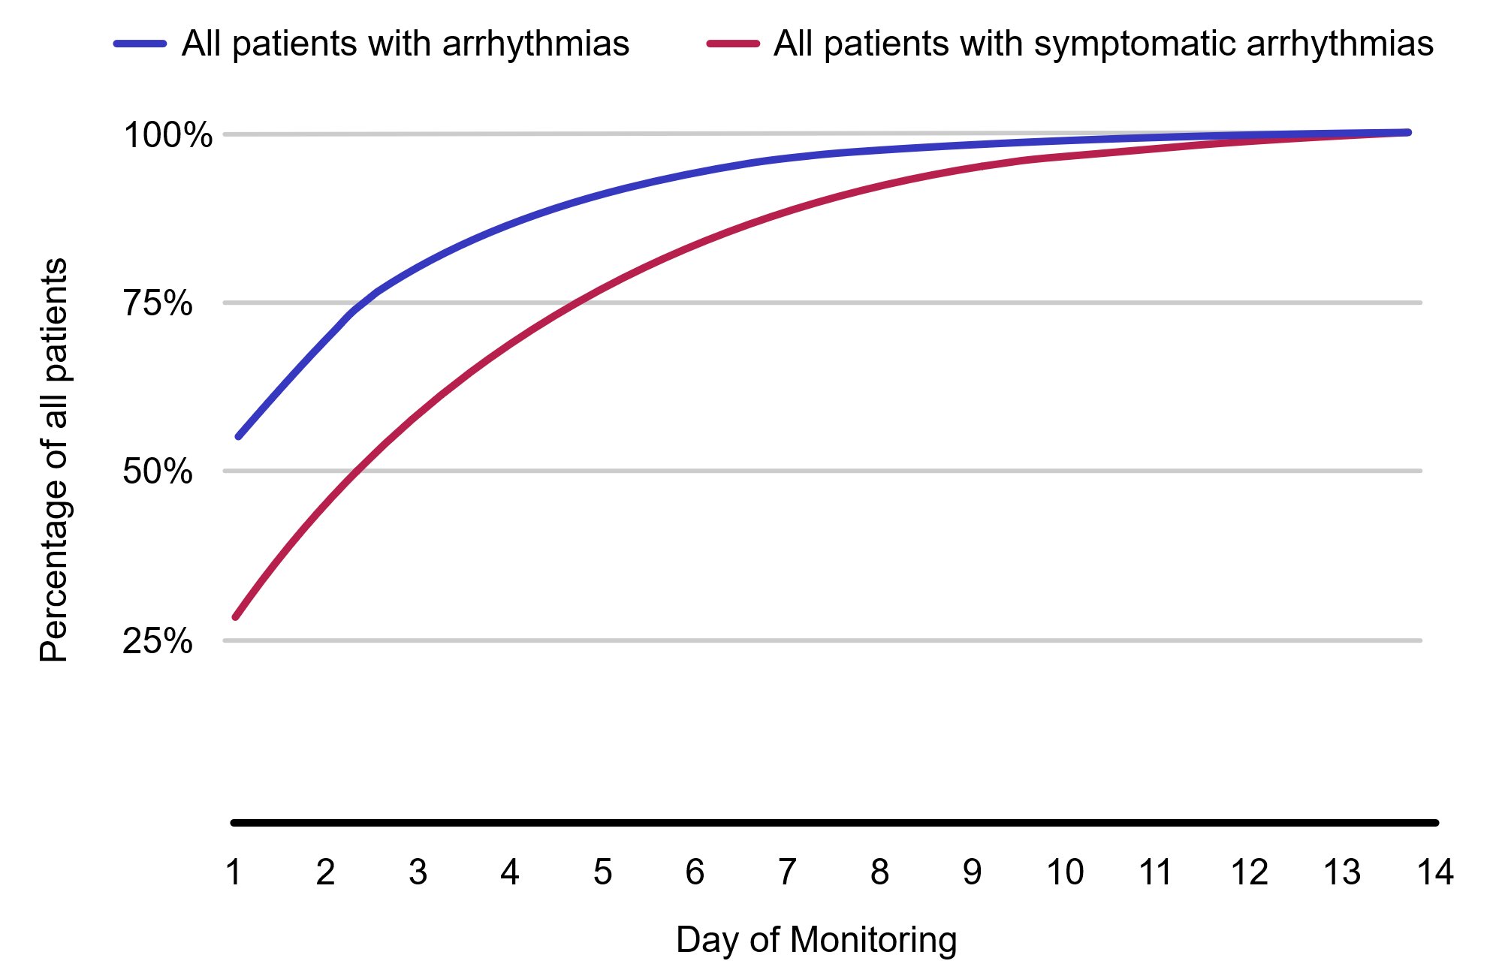
Increased Analyzable Time Improves Diagnostic Yield
LONG-TERM CONTINUOUS MONITORS (LTCM)
Impact of longer monitoring duration:
Day 7: 90% DX Yield
Day 14: DX Yield
51.1% of arrhythmias were identified beyond 1–2 days
Turakhia MP, Hoang DD, Zimetbaum P, et al. Diagnostic utility of a novel leadless arrhythmia monitoring device. The American Journal of Cardiology. 2013;112(4):520-524. doi:10.1016/j.amjcard.2013.04.017

Slide 25
LONG-TERM CONTINUOUS MONITORS (LTCM)
Actionable Diagnostic Yield Outperforms Holter
28.4%
of LTCM patients had a change in their clinical management
Rosenberg et al., Use of a Noninvasive Continuous Monitoring Device in the Management of Atrial Fibrillation: A Pilot Study. Pacing and Clinical Electrophysiology, 2013.

Slide 26
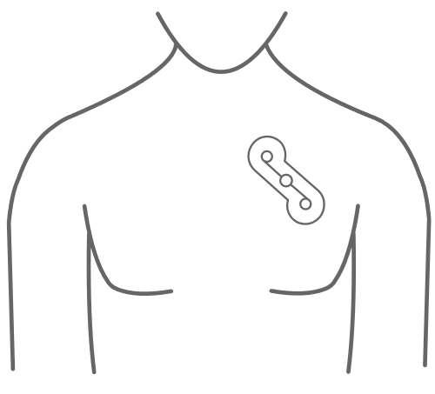
Increased Analyzable Time Outperforms MCT
LONG-TERM CONTINUOUS MONITORS (LTCM)
Findings on the effectiveness of patch-based
Zio XT LTCM vs 3 Lead MCT in the COMPARE study:
Longer wear time
Zio XT LTCM: 13.4 days
3 Lead MCT: 12.7 days
Reduction in missing data
Zio XT LTCM: 0.28 days
3 Lead MCT: 6.6 days
Garg, L., Moss, J., Hyman, M. C., . (2023). Simultaneous comparison of patch versus multielectrode cardiac monitoring for the detection of arrhythmias: The COMPARE study. Heart Rhythm, 20(8), 1202–1203.

Slide 27
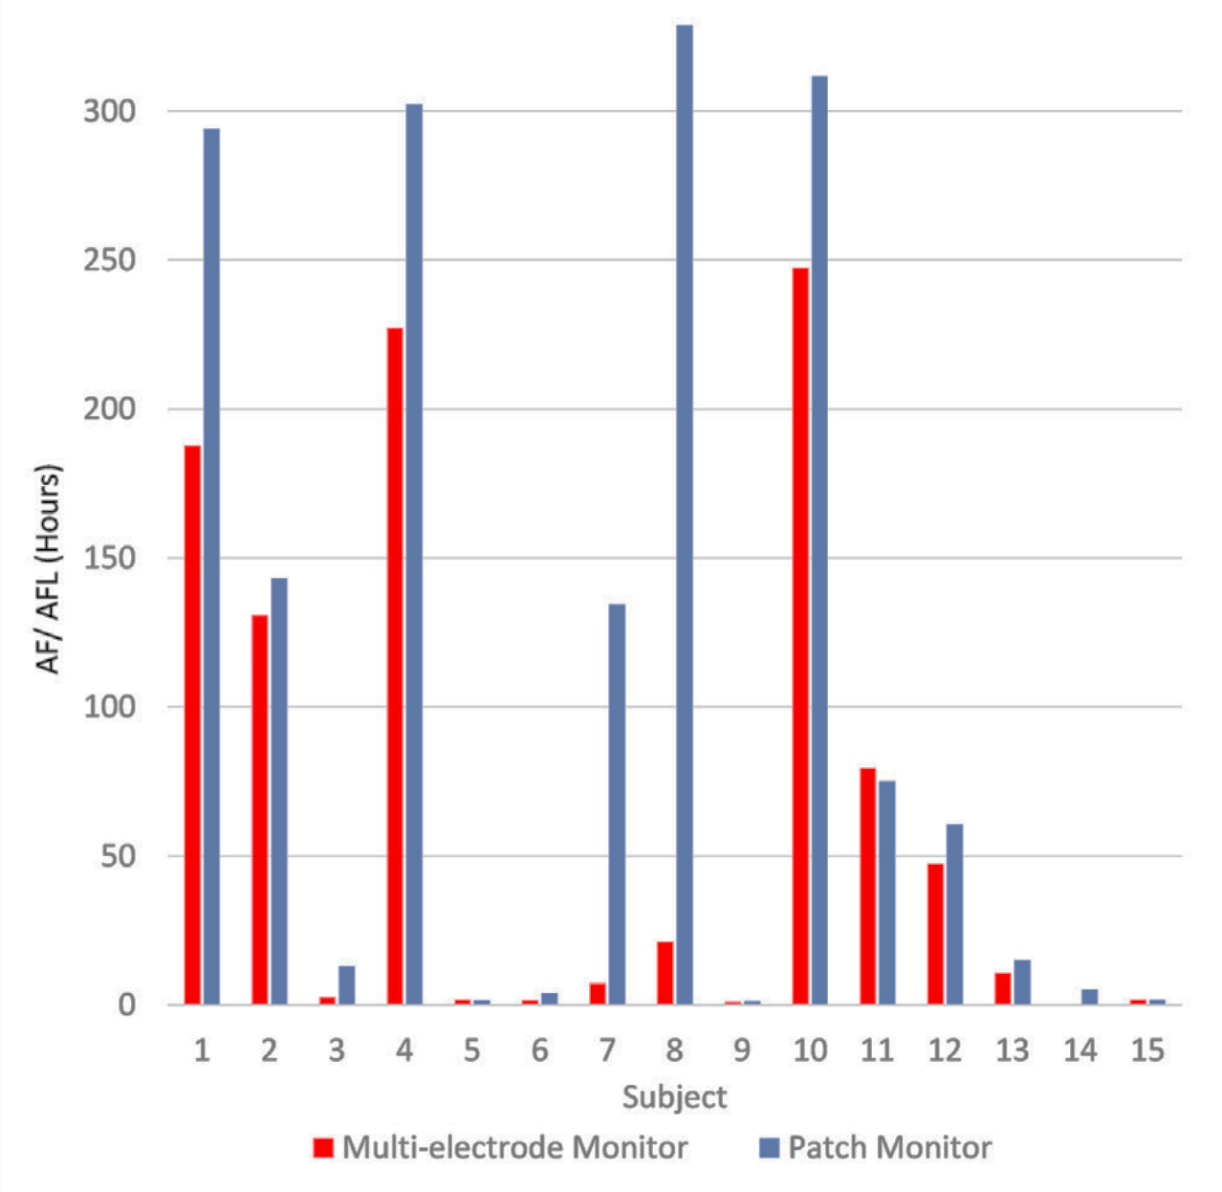
Recorded Time in AF Discrepancy Outperforms MCT
LONG-TERM CONTINUOUS MONITORS (LTCM)
300
250
200
150
AF TIME (HOURS)
100
50
0
1
2
3
4
5
6
7
8
9
10
11
12
13
14
15
3 Lead MCT
Zio XT LTCM
SUBJECT
Garg, L., Moss, J., Hyman, M. C., . (2023). Simultaneous comparison of patch versus multielectrode cardiac monitoring for the detection of arrhythmias: The COMPARE study. Heart Rhythm, 20(8), 1202–1203.

Slide 28
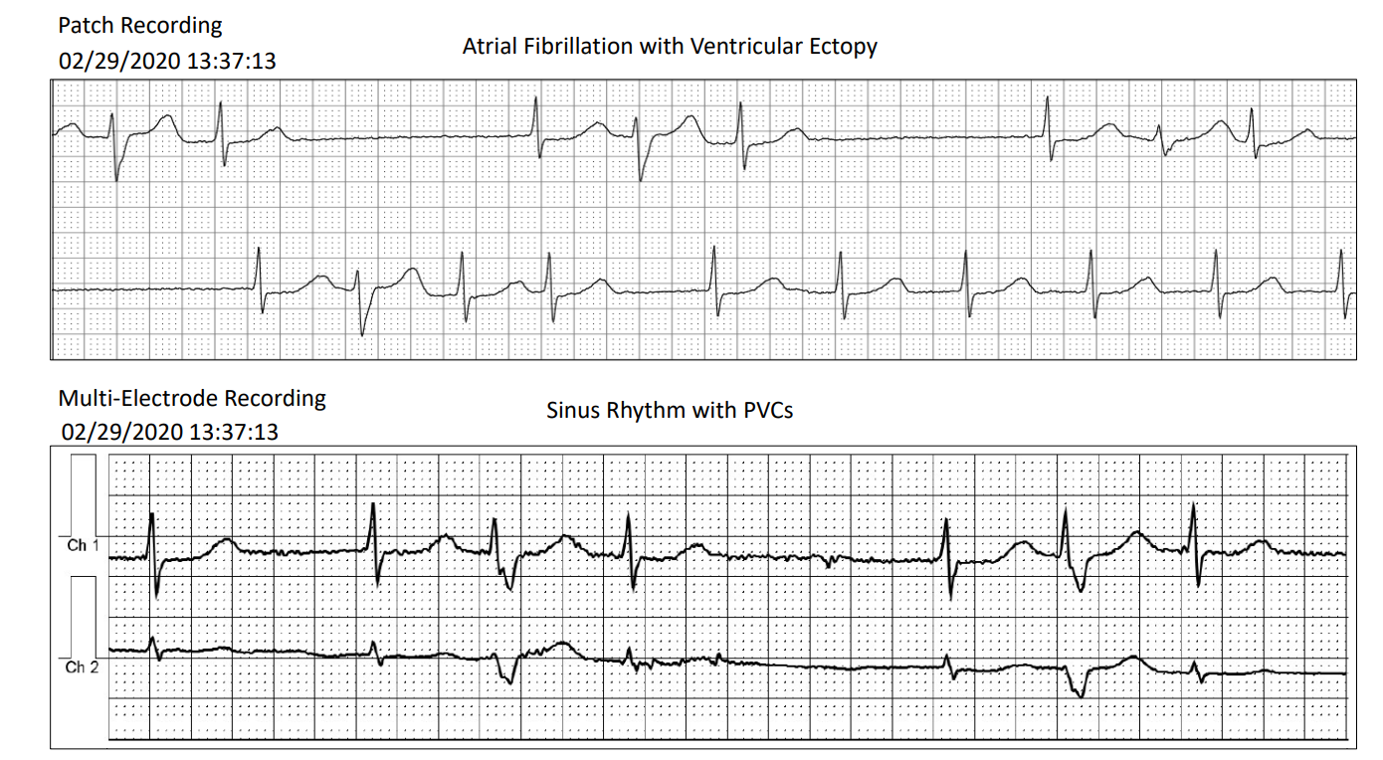
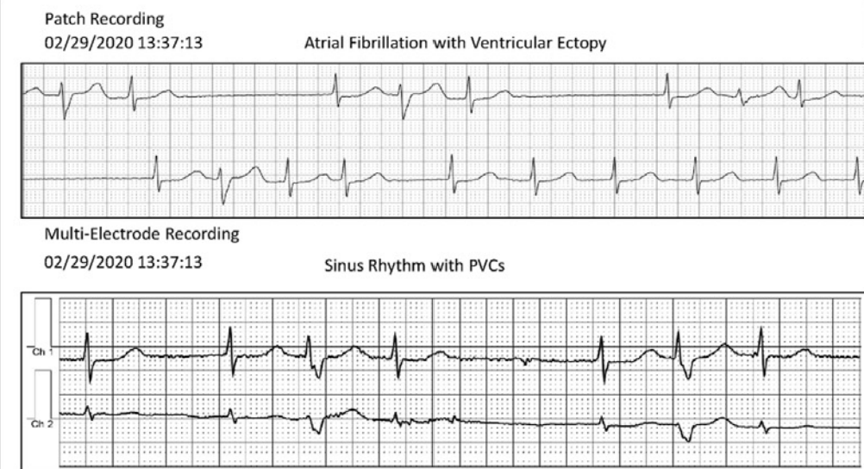
Improved Signal Clarity Outperforms MCT
LONG-TERM CONTINUOUS MONITORS (LTCM)
Patch-based LTCM:
Correctly identifies AF/AFL
3 Lead MCT:
AF misidentified as NSR with PVCs
Garg, L., Moss, J., Hyman, M. C., . (2023). Simultaneous comparison of patch versus multielectrode cardiac monitoring for the detection of arrhythmias: The COMPARE study. Heart Rhythm, 20(8), 1202–1203.

Slide 29
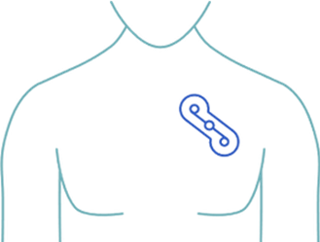
When to Consider a LTCM
LONG-TERM CONTINUOUS MONITORS (LTCM)
  When symptoms are:
    Absent or present
    Less frequent (48+ hours)
  When patients:
    Need treatment stratification for channelopathies or cardiomyopathies
    Need symptom-rhythm correlation assessment
DATA URGENCY
Long-Term
Continuous Monitor
SYMPTOM FREQUENCY
MONITORING DURATION
Disclaimer: Ambulatory monitoring devices are intended for use in routine, non-acute settings and are not designed for high-risk patients or those requiring continuous, intensive care.

Slide 30
When to Consider a LCTM
LONG-TERM CONTINUOUS MONITORS (LTCM)
Mobile Cardiac
Telemetry
DURING WEAR
MONITORING
DATA URGENCY
Implantable Loop Recorder
Long-Term Continuous
Monitor
Event Recorder
RETROSPECTIVE
MONITORING
Wearables
Holter Monitor
SYMPTOM FREQUENCY
MONITORING DURATION
Disclaimer: Ambulatory monitoring devices are intended for use in routine, non-acute settings and are not designed for high-risk patients or those requiring continuous, intensive care.

Slide 31

Solutions and Recommendations
Increased analyzable time = Increased diagnostic yield
Increase wear time: Improve patient compliance/Utilize monitors that require less from patient
Prevent data loss: Utilize monitors with less artifact and less patch/battery changes
Reduce clinic burden: Utilize monitors with AI and an IDTF to review the data
Monitors vary by manufacturer.
Learn about the differences and chose
one with the patient in mind.
Reynolds et al. Comparative effectiveness and healthcare utilization for ambulatory cardiac monitoring strategies in Medicare beneficiaries. Am Heart J. 2024;269:25–34. Accessed January 2, 2024. https://doi.org/10.1016/j.ahj.2023.12.002

Slide 32

During-Wear Transmission Monitors

Slide 33
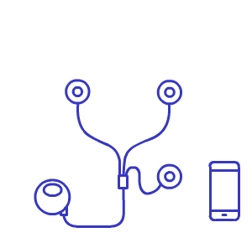
Event Recorders
1990

Slide 34
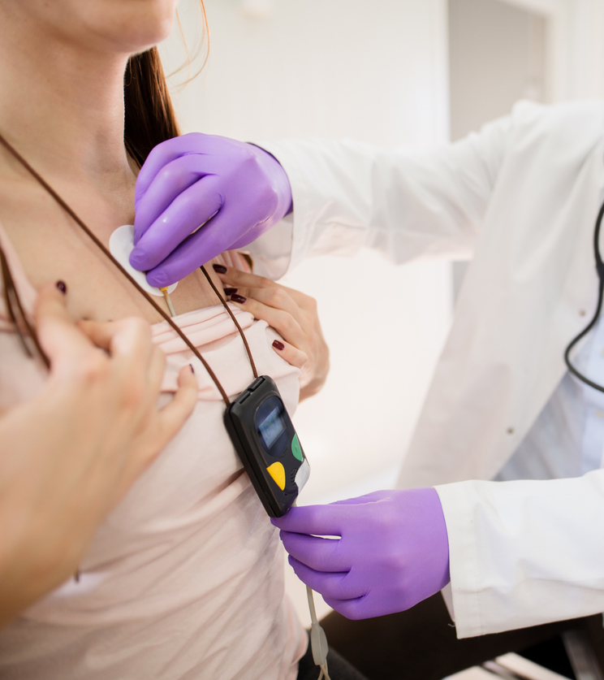
EVENT RECORDERS
How They Work
  Staff applies in clinic and teaches patient how to place electrodes and transmit data *
  Patient wears device for up to 30 days
  Symptomatic: ECG recorded when patient initiates symptom trigger; auto-trigger for preset thresholds​
    Symptoms recorded in paper diary or app
  Patient initiates data transmission periodically*
  Patient returns device to clinic*
  Clinic staff or central validation site review data*
*Varies by Manufacturer

Slide 35
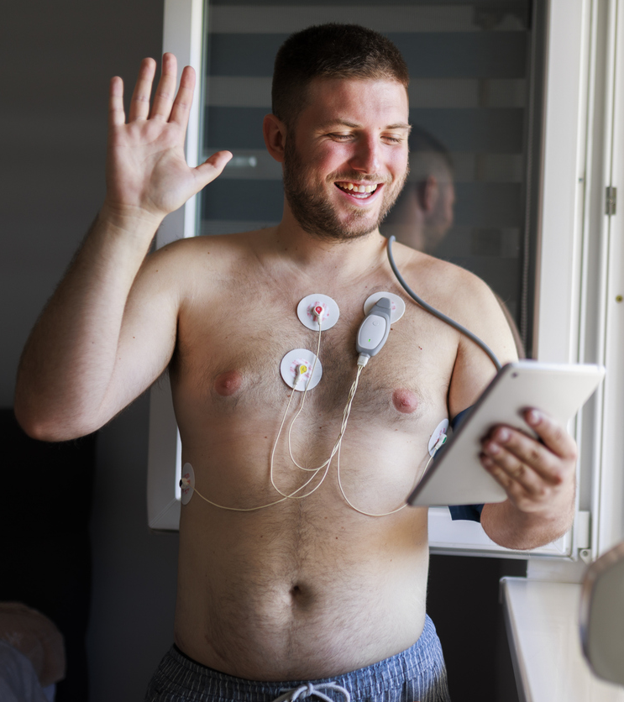

EVENT RECORDERS
Data Outputs
  Clinic staff reads data OR data sent wirelessly to central validation site*
  Final report details rhythm during symptoms to correlate rhythm-symptom correlation
    Limitations:
    No information on asymptomatic episodes*
    Limited storage, data can be lost if not periodically transmitted
*Varies by Manufacturer

Slide 36
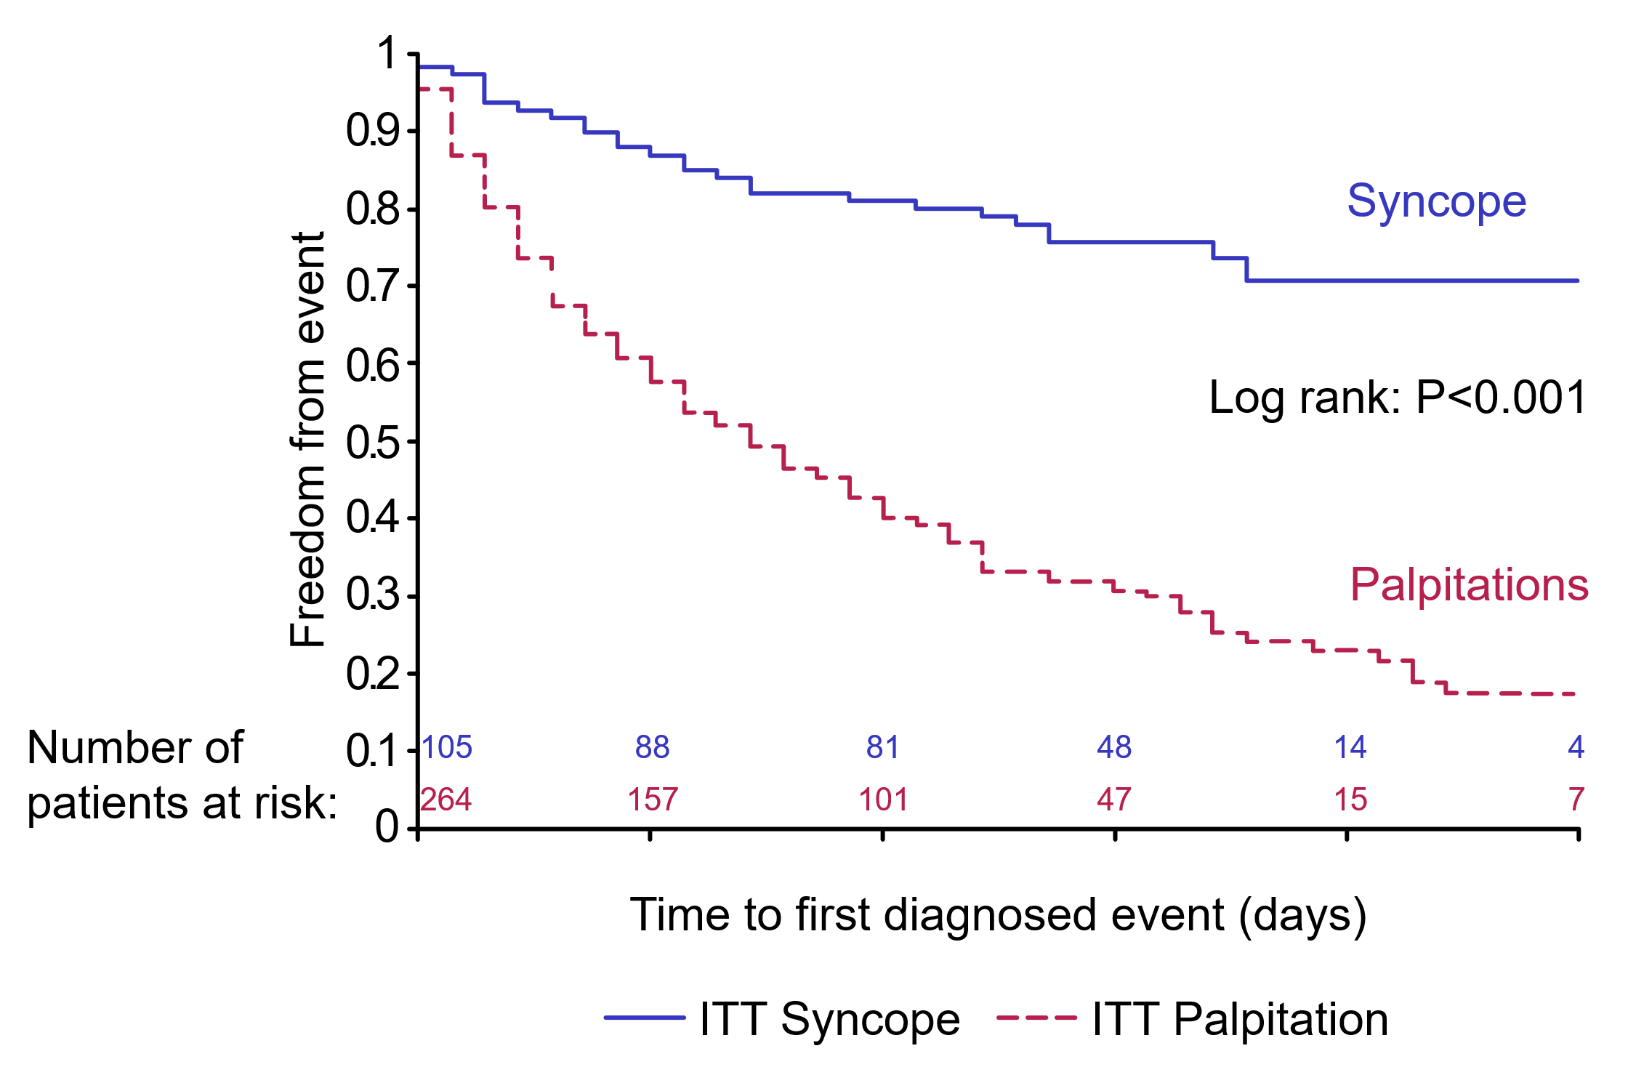
Diagnostic Yield Outperforms Holter Monitors
EVENT RECORDERS
SYNARR-Flash study:
4-week Event Recorder diagnostic yield was
30%
Locati ET, Moya A, Oliveira M, et al. External prolonged electrocardiogram monitoring in unexplained syncope and palpitations: results of the SYNARR-Flash study. EP Europace. 2015;18(8):1265-1272. doi:10.1093/europace/euv311

Slide 37
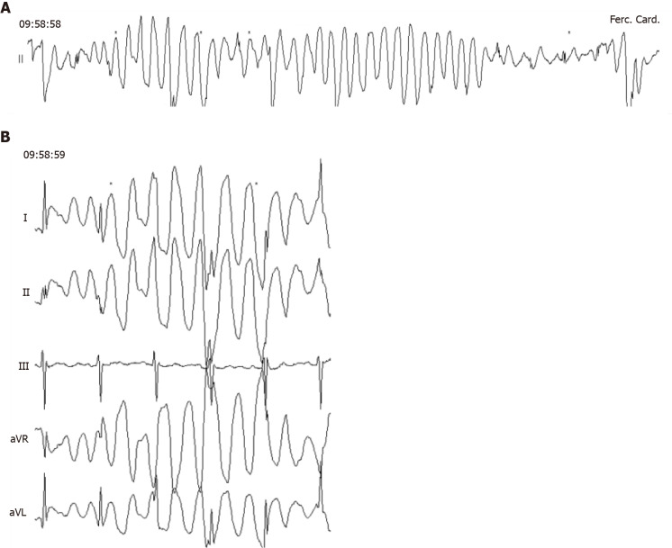





EVENT RECORDERS
Limitations of Event Recorders
No data on asymptomatic arrhythmias
Not suitable for assessment of channelopathies or cardiomyopathies
Multiple leads needed to help understand artifact
Lead placement is dependent on patient
Artifact
Recording limitations
Francisco-Pascual J, Cantalapiedra-Romero J, Pérez-Rodon J, et al. Cardiac monitoring for patients with palpitations. World Journal of Cardiology. 2021;13(11):608-627. doi:10.4330/wjc.v13.i11.608

Slide 38
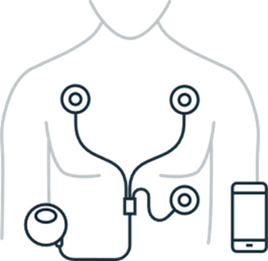
When to Consider an Event Recorder
EVENT RECORDERS
  When symptoms are:
      Less frequent (14+ days)
      Low severity
      Long-lasting
  When patients:
      Are capable of recording, charging device, and sending recordings
DATA URGENCY
Event Recorder
SYMPTOM FREQUENCY
MONITORING DURATION

Slide 39
When to Consider an Event Recorder?
EVENT RECORDERS
Mobile Cardiac
Telemetry
DURING WEAR
MONITORING
DATA URGENCY
Implantable Loop Recorder
Long-Term Continuous
Monitor
Event Recorder
RETROSPECTIVE
MONITORING
Wearables
Holter Monitor
SYMPTOM FREQUENCY
MONITORING DURATION

Slide 40

Mobile Cardiac Telemetry (MCT)
2009

Slide 41

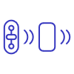
MOBILE CARDIAC TELEMETRY (MCT)
How They Work
  Single-lead patch monitor (or 3-lead wired) placed in clinic or mailed with transmitter*
  Continuous: ECG recorded for up to 30 days*
  Symptomatic: ECG recorded upon symptom trigger
    Symptoms recorded in paper diary or app
  Asymptomatic: Auto-trigger for preset thresholds
  ECG Data transmitted at auto-trigger or symptom
  Monitoring center staff reviews rhythm data; notifies clinician as needed
  Device returned in clinic or sent via mail*
Limitation: Data transmission subject to transmitter proximity, cellular signal, QCT review, and MD response to notification
*Varies by Manufacturer

Slide 42



MOBILE CARDIAC TELEMETRY (MCT)
Data Outputs
  Independent Diagnostic Testing Facility (IDTF) receives recording
  AI analyzes ECG beat-to-beat data (similar to LTCM) and identifies arrhythmias*
  Qualified Cardiac Technicians review ECG data 24/7 band escalates to clinician as needed*
  Final report curated with symptom-triggered events, heart rate and rhythm trends
    Examples: AF burden, PVC Burden, PVC by unique morphology*
Limitation: Increased staff burden to review notifications*
*Varies by Manufacturer

Slide 43
Improved Diagnostic Yield
MOBILE CARDIAC TELEMETRY (MCT)
Asymptomatic Arrhythmia | MCT/Event Diagnostic Yield Ratio | 95% Confidence Interval | P = | Mean Time to Diagnosis (Days)
 |  |  |  | MCT | Event
AF | 2.28 | 2.10–2.48 | <0.001 | 6.2 | 8.1
Brady | 1.54 | 1.50–1.59 | <0.001 | 5.0 | 6.0
Pause | 1.17 | 1.02–1.34 | 0.026 | 5.4 | 12.1
SVT | 1.8 | 1.67–1.94 | <0.001 | 9.2 | 11.7
VT | 23.2 | 18.2–29.6 | <0.001 | 9.0 | 12.0
MCT identifies an arrhythmia in significantly more patients than patient-triggered event recorders
Derkac WM, Finkelmeier JR, Horgan DJ, Hutchinson MD. Diagnostic yield of asymptomatic arrhythmias detected by mobile cardiac outpatient telemetry and autotrigger looping event cardiac monitors. Journal of Cardiovascular Electrophysiology. 2017;28(12):1475-1478. doi:10.1111/jce.13342

Slide 44

Cryptogenic Stroke Monitoring
MOBILE CARDIAC TELEMETRY (MCT)
13.8% of patients had AF detected in first 30 days
Ease of use → Determine cause of stroke sooner
Can reduce need for ILR
Limitation: Mean compliance was 75.6%
Defined as the total ideal duration of monitoring.
Jiang H, Tan SY, Wang JK, et al. A meta-analysis of extended ECG monitoring in detection of atrial fibrillation in patients with cryptogenic stroke. Open Heart. 2022;9(2):e002081. doi:10.1136/openhrt-2022-002081

Slide 45
Lower Healthcare Costs
MOBILE CARDIAC TELEMETRY (MCT)
INPATIENT CARDIOVASCULAR COST SAVINGS
Higher
diagnostic yield
 | Valve Procedures | Pericardium Procedures | CABG | Cardiac Ablation
MCT vs. Event | $58,362 | $17,131 |  | $35,114
MCT vs. Holter | $55,390 | $8,606 | $41,700 | $36,115
Lower
healthcare costs
Tsang JP, Mohan S. Benefits of monitoring patients with mobile cardiac telemetry (MCT) compared with the Event or Holter monitors. Med Devices (Auckl). 2013 Dec 9;7:1-5. doi: 10.2147/MDER.S54038.

Slide 46
When to Consider Mobile Cardiac Telemetry
MOBILE CARDIAC TELEMETRY (MCT)
  When symptoms are:
    Variable frequency (15+ days)
    Needing quick ECG correlation Example: syncope, cryptogenic stroke
  When patients:
    Need assessment of arrhythmia/burden during wear
    Need rhythm review during wear
    Need clinical action during wear
Mobile Cardiac
Telemetry
DATA URGENCY
SYMPTOM FREQUENCY
MONITORING DURATION
Disclaimer: Ambulatory monitoring devices are intended for use in routine, non-acute settings and are not designed for high-risk patients or those requiring continuous, intensive care.

Slide 47
MOBILE CARDIAC TELEMETRY (MCT)
When to Consider Mobile Cardiac Telemetry
Mobile Cardiac
Telemetry
DURING WEAR
MONITORING
DATA URGENCY
Implantable Loop Recorder
Long-Term Continuous
Monitor
Event Recorder
RETROSPECTIVE
MONITORING
Wearables
Holter Monitor
SYMPTOM FREQUENCY
MONITORING DURATION
Disclaimer: Ambulatory monitoring devices are intended for use in routine, non-acute settings and are not designed for high-risk patients or those requiring continuous, intensive care.

Slide 48



Common MCT Misconceptions
MCT is:
  A monitoring service that provides transmissions during wear with 24-hour IDTF review and notifications
  A notification system for the ordering physician, not the patient
MCT is not:
  A streaming telemetry
  A real-time telemetry (based on manufacturer)
  A way to mitigate risk of catastrophic arrhythmias or sudden cardiac death
  A therapeutic device

Slide 49

Solutions and Recommendations
Increased analyzable time = Increased diagnostic yield
Increased wear time: Improve patient compliance/Utilize monitors that require less from patient
Prevent data loss: Utilize monitors with less artifact and less patch/battery changes
Reduce clinic burden: Utilize monitors with AI and an IDTF to review the data
Monitors vary by manufacturer.
Learn about the differences and chose one
with the patient in mind.
Reynolds et al. Comparative effectiveness and healthcare utilization for ambulatory cardiac monitoring strategies in Medicare beneficiaries. Am Heart J. 2024;269:25–34. Accessed January 2, 2024. https://doi.org/10.1016/j.ahj.2023.12.002

Slide 50

External ECG Data
RETROSPECTIVE MONITORS
DURING WEAR TRANSMISSION MONITORS
 | Holter Monitor | Long-Term Continuous Monitor | Event Recorder | Mobile Cardiac Telemetry
Continuous
Asymptomatic
Symptomatic
Duration of Data | 24–48 hours | 3–15 days* | Up to 30 days* | Up to 30 days*
*
*
*
*Varies by Manufacturer
Spatz ES, Ginsburg GS, Rumsfeld JS, Turakhia MP. Wearable digital health technologies for monitoring in cardiovascular medicine. New England Journal of Medicine. 2024;390(4):346-356. doi:10.1056/nejmra2301903

Slide 51

Are Patch-Based Monitors the Future?
Traditional Lead Monitors
Patch-Based Monitors
  Holter, Event, and MCT options
  Multiple lead vectors provide directionality
  Review of ECGs higher burden on clinic staff
  Reduced compliance and wear time due to required patient manipulations
  Increased healthcare utilization/costs over time¹ (Lower upfront costs but higher retest rates)
  Holter, LTCM, Event, and MCT options
  Minimal artifact
  Utilize AI and IDTF centers
  Simplified wear, higher patient compliance
  Water resistant
  Improves diagnostic yield
  Reduced healthcare utilization
  (Higher upfront cost but lower retest rates)
Reynolds et al. Comparative effectiveness and healthcare utilization for ambulatory cardiac monitoring strategies in Medicare beneficiaries. Am Heart J. 2024;269:25–34. Accessed January 2, 2024. https://doi.org/10.1016/j.ahj.2023.12.002

Slide 52

Quality ECG data (signal clarity)
+
Quality QCT (& AI)
=
Quality Reports
Not all ECG patches
are the same
VARIABLES
Wear duration
Device manipulations by patient
Patient compliance
Artifact
Diagnostic yield
AI

Slide 53
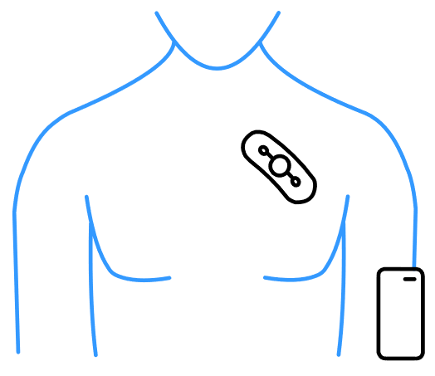
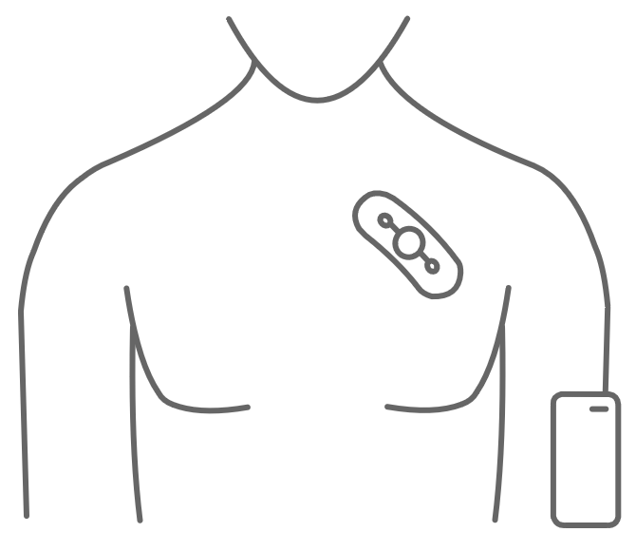
The Consequences of Missing ECG Data
High Compliance
Clean Signal
Uninterrupted Wear
Total analyzable time is close to wear time
  No device maintenance
  Reduced artifact
Increased patient compliance
DAY 1
DAY 14
COMPLIANCE LEVEL
Actual Wear Time
Low Compliance
Artifact
Interrupted Wear
Total analyzable time is less than wear time
  Battery changes
  Lead manipulations
  Increased artifact
Decreased patient compliance
DAY 1
DAY 30
Actual Wear Time
CONSEQUENCE

Slide 54
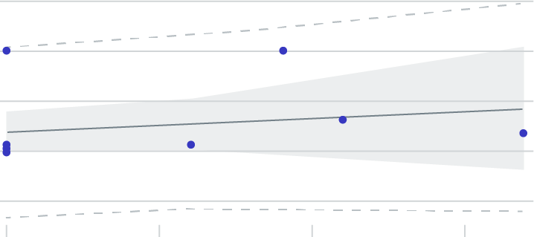
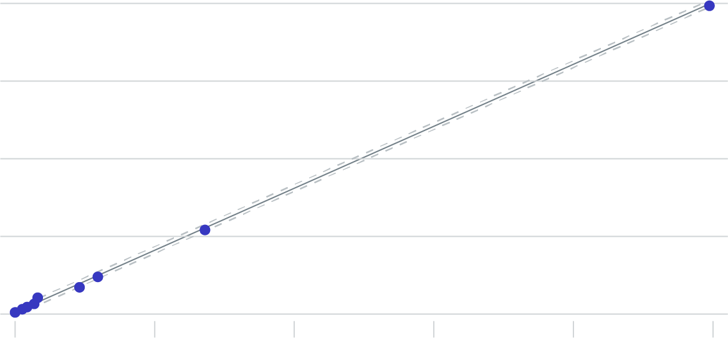
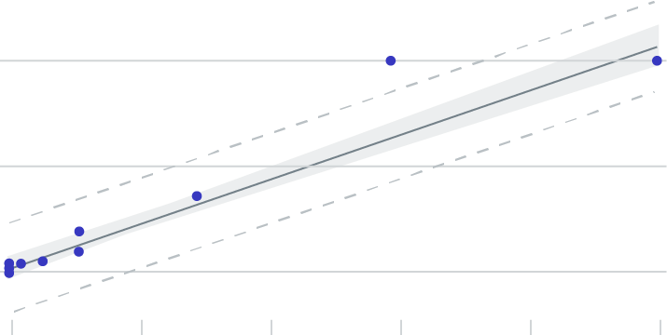
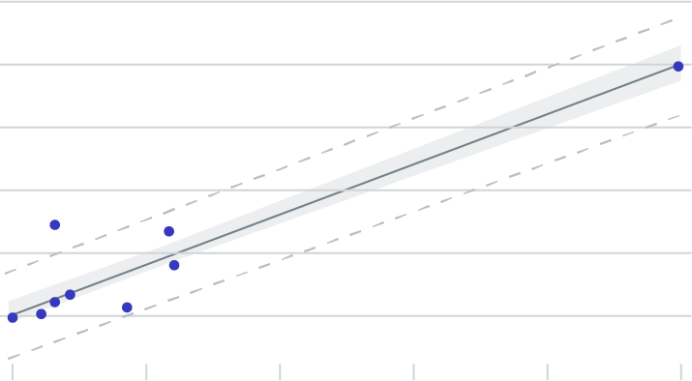
Quality ECG Data
Patch Monitors vs PPM: Accuracy of Detecting AFib
150
100
Novacor “R” Test IV
R²: 0.029
MSE: 1556.1
50
0
-50
0
5
10
15
Zio XT | R²: 0.99 | MSE: 0.24
% AF Burden (Novacor “R” Test IV)
100
100
75
% AF Burden (permanent pacemaker)
50
NUUBO Vest
R²: 0.94
MSE: 84.65
% AF Burden (permanent pacemaker)
50
0
0
20
40
60
80
100
25
0
% AF Burden (NUUBO Vest)
0
20
40
60
80
100
125
% AF Burden (Zio XT)
100
75
Carnation Ambulatory Monitor
R²: 0.96
MSE: 60.1
50
25
0
0
20
40
60
80
100
Eysenck et al., Journal of Interventional Cardiac Electrophysiology, 2019. publication link
% AF Burden (CAM)

Slide 55
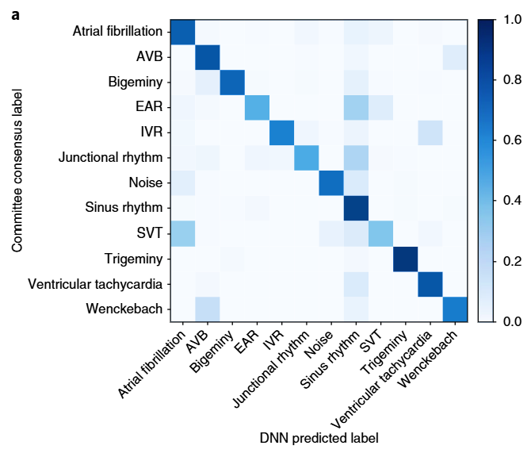
Quality AI
AI Application in ACM's
AI PLATFORM
​(34-LAYER DEEP ​NEURAL NETWORK)​
Only one FDA-cleared deep-learned algorithm that detects 13 types of arrhythmia classes that has been included as part of the CPT code validation process.
Clinically proven to be as accurate
as expert cardiologists.
Hannun et al., Cardiologist-level arrhythmia detection and classification in ambulatory electrocardiograms using a deep neural network. Nature Medicine, 2019.

Slide 56
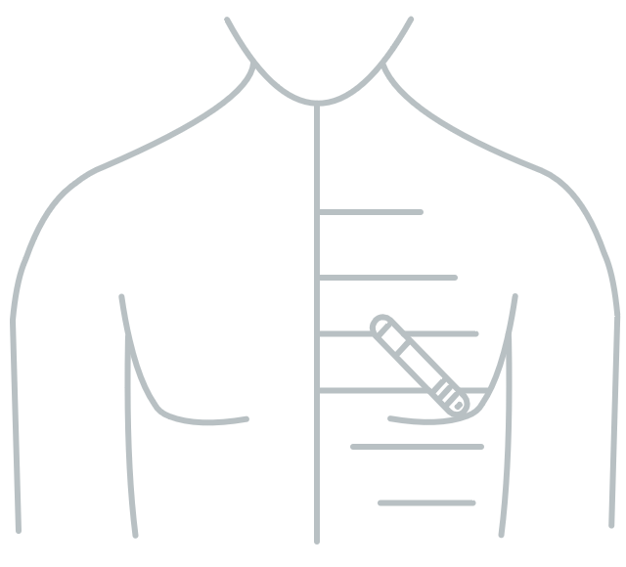
Implantable Loop Recorder (ILR)
2004

Slide 57



IMPLANTABLE LOOP RECORDER (ILR)
How They Work
  Physician implants single-lead device subcutaneously into pre-pectoral region
  Patient-activated transmission or auto-trigger on preset thresholds
  Clinicians review data on CIED portal
  Device is removed 3-6 years later*
    Benefits: Does not limit physical activity or sleep. Helpful for infrequent symptoms >30 days or burden monitoring.
    Limitations: Infection risk, high cost/ insurance coverage restrictions
*Varies by Manufacturer

Slide 58


IMPLANTABLE LOOP RECORDER (ILR)
Data Outputs
  Data is transmitted wirelessly via Bluetooth connection to phone-based app or bedside transponder*
    Auto-transmitted via cellular network
  Manufacturer portal captures HR, activity, and rhythm trends, including arrhythmia frequency, AF Burden, and PVC Burden, along with threshold/patient triggered events*
    Limitations: Susceptible to false AFib burden and pause detections, high clinic burden, delay in transmission
*Varies by Manufacturer

Slide 59
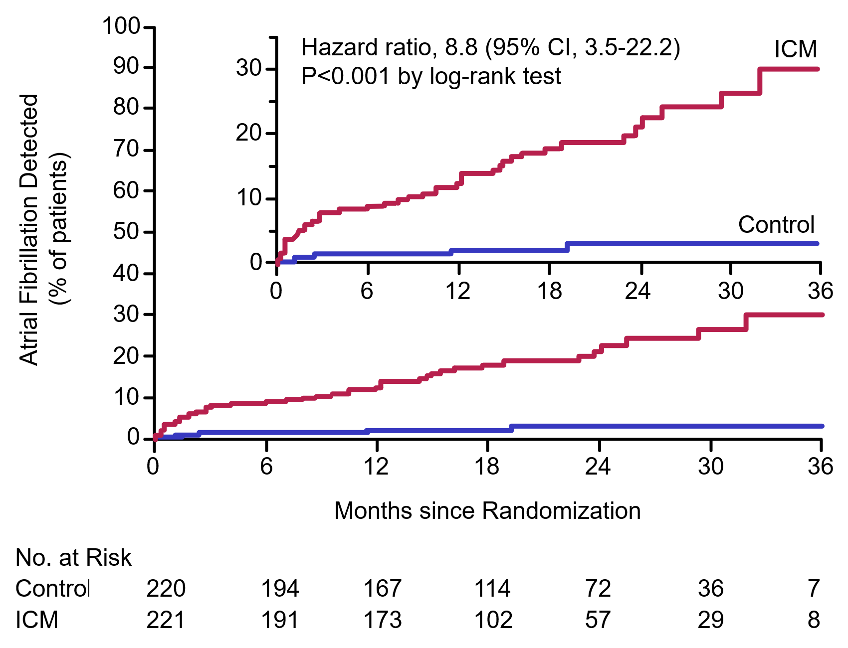
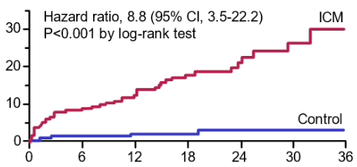
Improved Diagnostic Yield
IMPLANTABLE LOOP RECORDER (ILR)
CRYSTAL AF STUDY FINDINGS
AF Detection was 10x greater in ICM vs in control arm
Sanna T, Diener HC, Passman RS, et al. Cryptogenic stroke and underlying atrial fibrillation. New England Journal of Medicine. 2014;370(26):2478-2486. doi:10.1056/nejmoa1313600

Slide 60
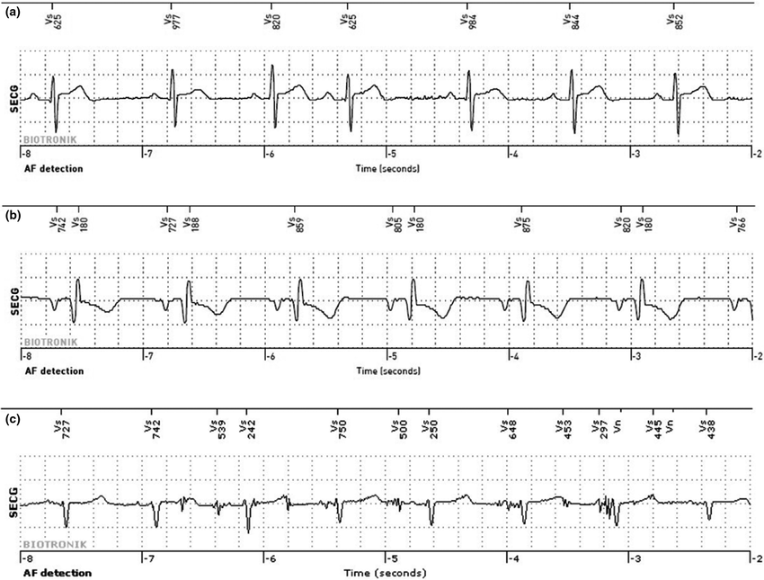
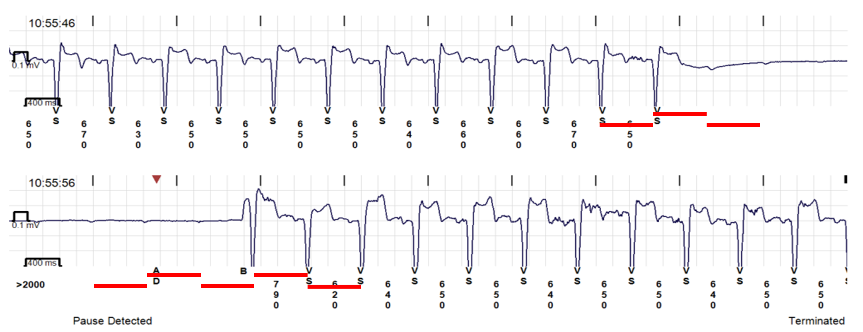
Limitation | False Positives
IMPLANTABLE LOOP RECORDER (ILR)
False AF alerts due to ectopy
As many as 46-86% of ILR alerts are false positives:
False AF alerts due to noise
PAC/PVC
False AFib detection
Poor signal detection
False pause detection
False pause alerts due to undersensing
O’Shea CJ, Middeldorp ME, Hendriks JM, et al. Remote Monitoring of Implantable loop Recorders: False-Positive Alert episode burden. Circulation Arrhythmia and Electrophysiology. 2021;14(11). doi:10.1161/circep.121.009635
Assaf A, Theuns D a. MJ, Sakhi R, Bhagwandien RE, Szili‐Torok T, Yap S. Accuracy of atrial fibrillation detection by an insertable cardiac monitor in patients undergoing catheter ablation: Results of the BioVAD study. Annals of Noninvasive Electrocardiology. 2022;27(3). doi:10.1111/anec.12960

Slide 61

IMPLANTABLE LOOP RECORDER (ILR)
Limitations | Cost and
Staff Burden
Increased
staff burden
  1,800+ patients rhythm monitors had 1,500 transmissions in 1 month
  EPs spent 37 hours reviewing transmissions, an estimated cost of $9,600
Increased
cost
Afzal MR, et al. Resource Use and Economic Implications of Remote Monitoring With Subcutaneous Cardiac Rhythm Monitors. JACC Clin Electrophysiol. 2021;7(6):745-754. doi:10.1016/j.jacep.2020.10.014

Slide 62
When to Consider an Implantable Loop Recorder
IMPLANTABLE LOOP RECORDER (ILR)
DATA URGENCY
Implantable Loop Recorder
  When symptoms are:
    Very infrequent (previous negative monitoring)
    Highly bothersome
  When patients:
    Need long-term arrhythmia trends and burden
    Close assessment for short lived arrhythmias
    Have difficulty wearing external monitors
SYMPTOM FREQUENCY
MONITORING DURATION
Disclaimer: Ambulatory monitoring devices are intended for use in routine, non-acute settings and are not designed for high-risk patients or those requiring continuous, intensive care.

Slide 63
When to Consider an Implantable Loop Recorder
IMPLANTABLE LOOP RECORDER (ILR)
Mobile Cardiac
Telemetry
DURING WEAR
MONITORING
DATA URGENCY
Implantable Loop Recorder
Long-Term Continuous
Monitor
Event Recorder
RETROSPECTIVE
MONITORING
Wearables
Holter Monitor
SYMPTOM FREQUENCY
MONITORING DURATION
Disclaimer: Ambulatory monitoring devices are intended for use in routine, non-acute settings and are not designed for high-risk patients or those requiring continuous, intensive care.

Slide 64
Consumer Wearable Devices

Slide 65
Types of Devices
CONSUMER WEARABLE DEVICES
 | Monitoring | Recording Type | Data Reported | Clinical Considerations
 | Patient Activated ECG | 30 seconds | Episodic | Ease of use/familiarity Patients can purchase on their own Allows for long-term monitoring for infrequent events May miss transient or asymptomatic events Increased staff burden Reimbursement varies Health disparity gap: $$$/sensitivity differences in Fitzpatrick scores
 | Passive Monitoring PPG | Intermittent | Asymptomatic AF
 | Patient Activated ECG & PPG | 30-60 seconds | Episodic
SMART WATCH
HANDHELD
Spatz ES, Ginsburg GS, Rumsfeld JS, Turakhia MP. Wearable digital health technologies for monitoring in cardiovascular medicine. New England Journal of Medicine. 2024;390(4):346-356. doi:10.1056/nejmra2301903

Slide 66
Consumer Wearable Devices Overview
CONSUMER WEARABLE DEVICES
Most watches use both PPG
(Passive Monitoring) and ECG
(Active Monitoring)
A meta-analysis of AFib detection found:
Smartwatches achieved a sensitivity of 94% and a specificity of 96%
No difference between devices that use PPG and single-lead ECG
Applications
  Patient-controlled evaluation of symptoms
  Monitoring for arrhythmia occurrence or recurrence
  Evaluating personal heart rate trends
Prasitlumkum N, Cheungpasitporn W, Chokesuwattanaskul A, et al. Diagnostic accuracy of smart gadgets/wearable devices in detecting atrial fibrillation: a systematic review and meta-analysis. Arch Cardiovasc Dis 2021; 114(1):4–16. doi:10.1016/j.acvd.2020.05.015

Slide 67
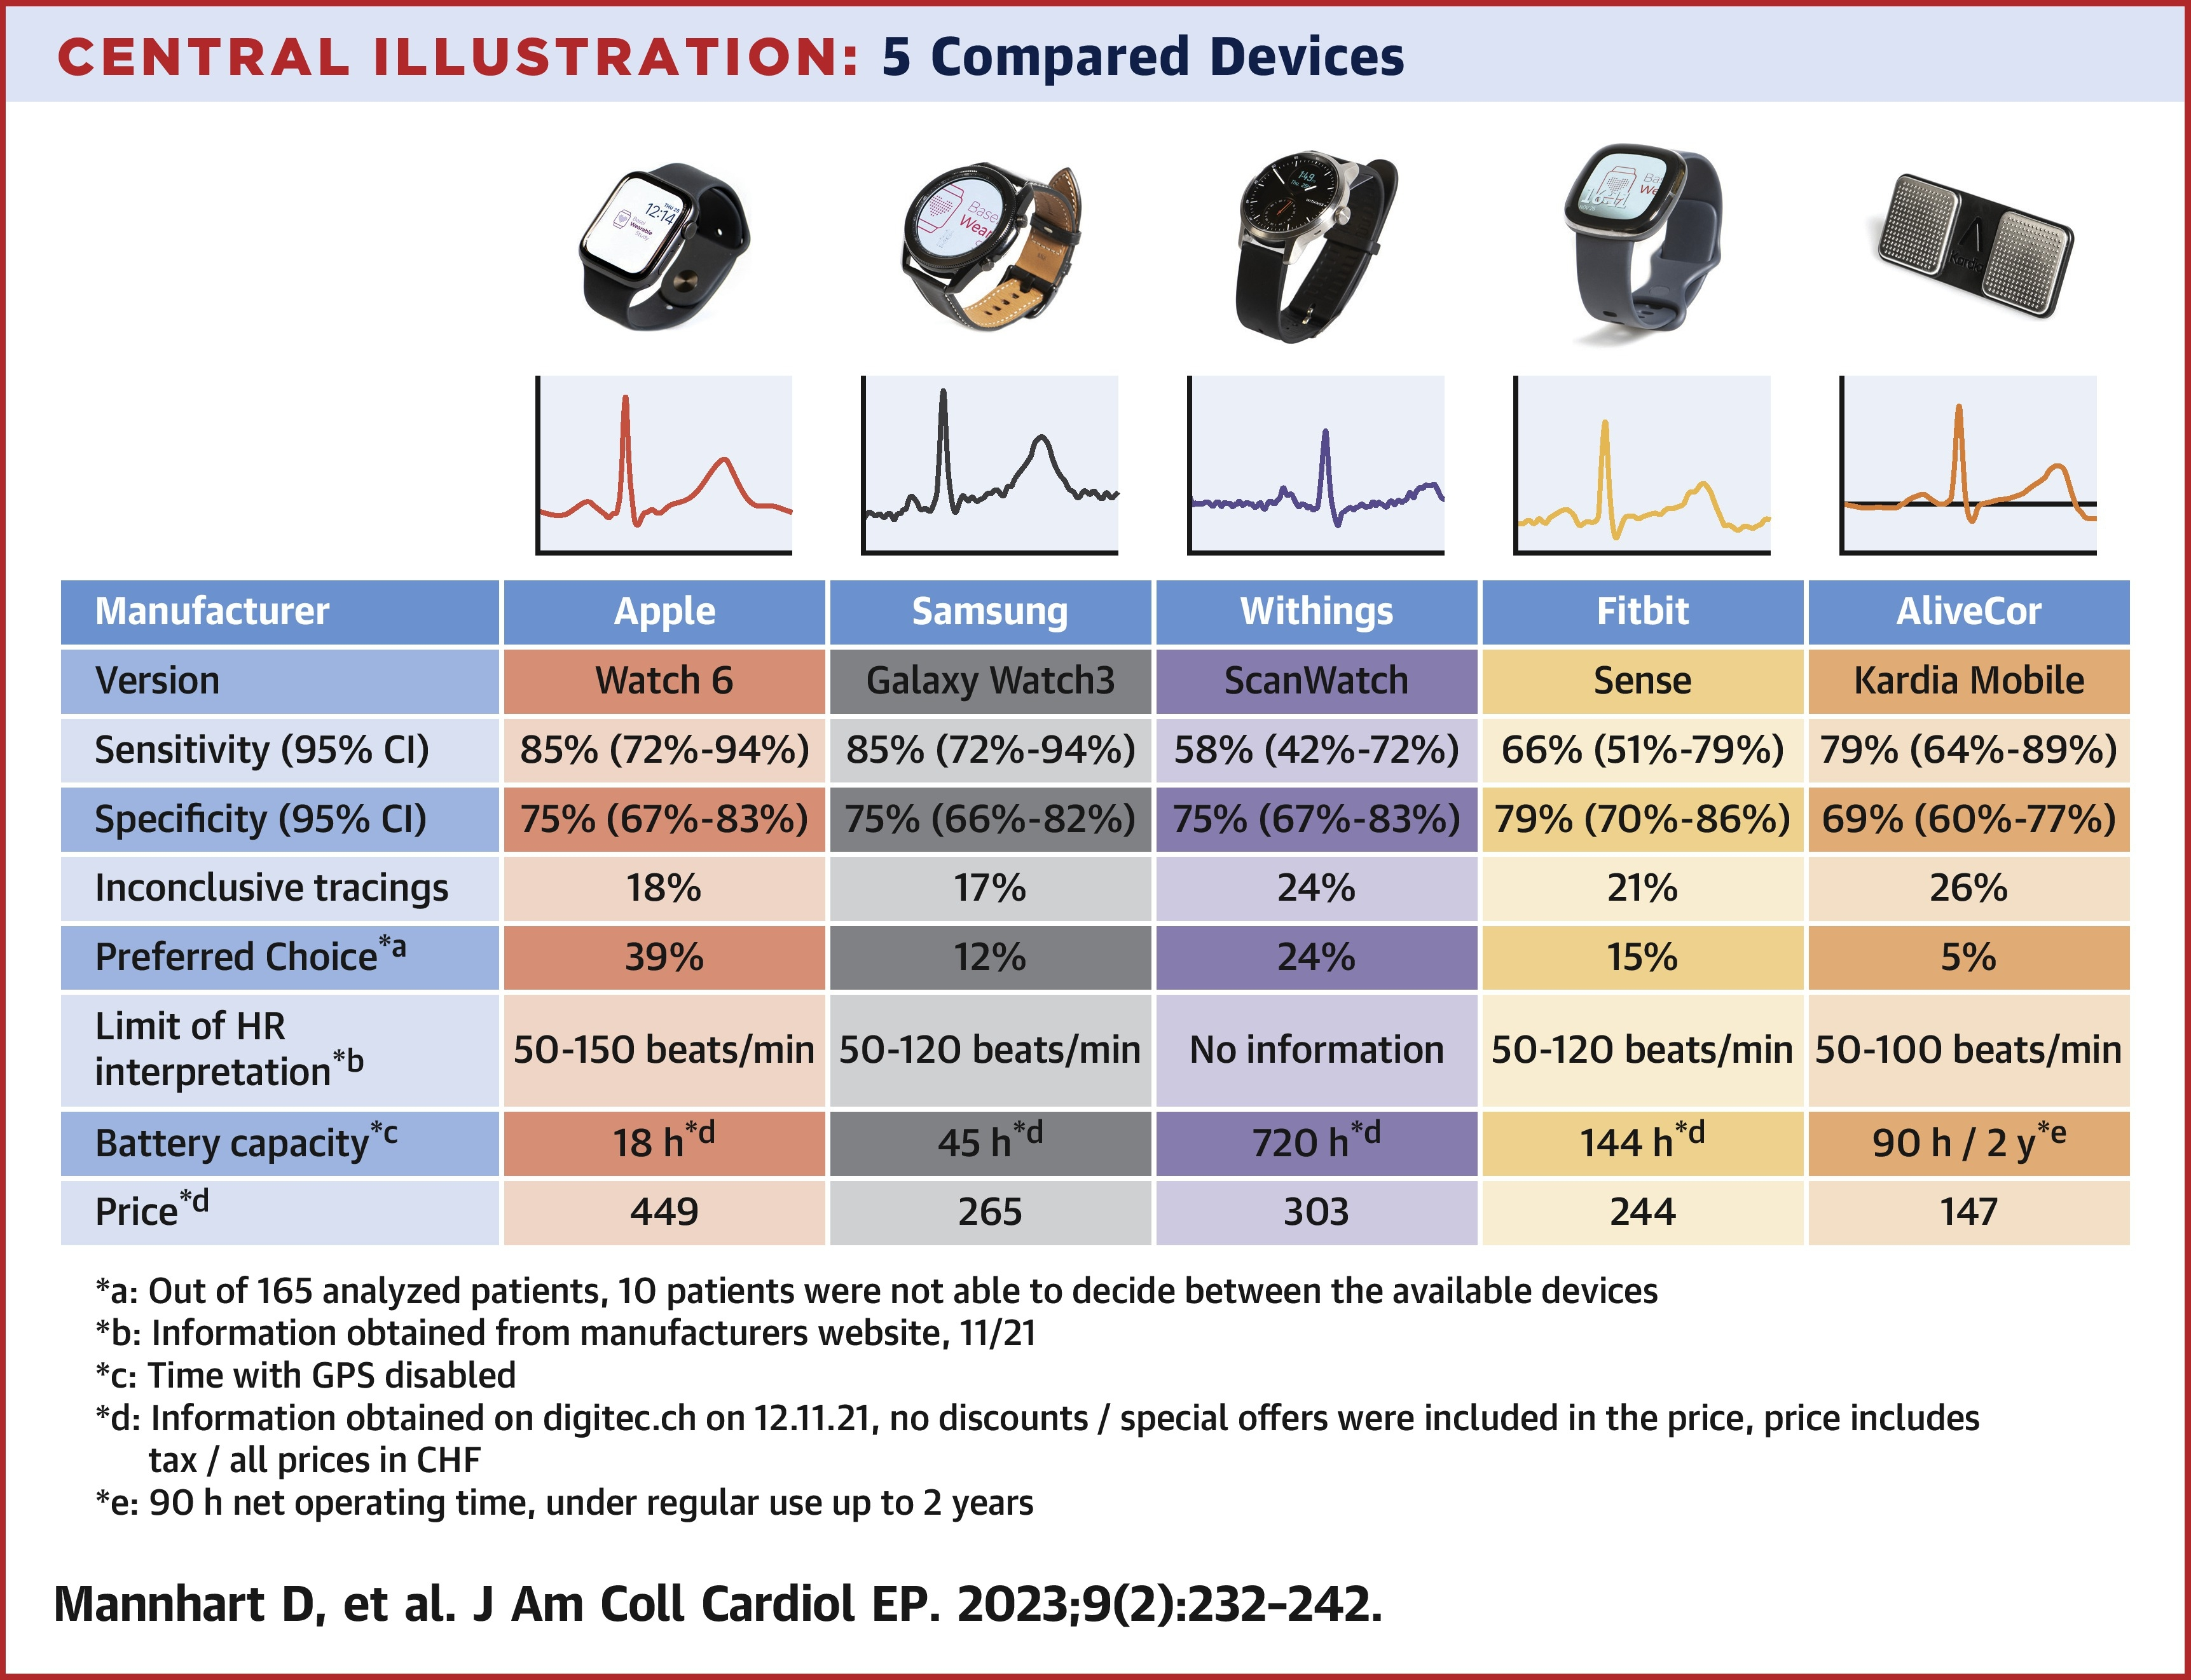
Consumer Wearable Devices Overview
CONSUMER WEARABLE DEVICES
Manufacturer | Apple | Samsung | Withings | Fitbit | AliveCor
Version | Watch 6 | Galaxy Watch3 | ScanWatch | Sense | Kardia Mobile
Sensitivity (95% CI) | 85% (72%–94%) | 85% (72%–94%) | 58% (42%–72%) | 66% (51%–79%) | 79% (64%–89%)
Specificity (95% CI) | 75% (67%–83%) | 75% (66%–82%) | 75% (67%–83%) | 79% (70%–86%) | 69% (60%–77%)
Inconclusive tracings | 18% | 17% | 24% | 21% | 26%
Preferred choiceª | 39% | 12% | 24% | 15% | 5%
Limit of HR interpretation^{b} | 50–150 beats/min | 50–120 beats/min | No information | 50–120 beats/min | 50–100 beats/min
Battery capacity^{c} | 18 h^{d} | 45 h^{d} | 720 h^{d} | 144 h^{d} | 90 h^{d} / 2 y^{e}
Price^{d} | 449 | 265 | 303 | 244 | 147
﻿a: Out of 165 analyzed patients, 10 patients were not able to decide between the available devices
﻿b: Information obtained from manufacturers website, 11/21
c: Time with GPS disabled
﻿d: Information obtained on digitec.ch on 12.11.21, no discounts / special offers were included in the price, price includes tax / all prices in CHF
﻿e: 90 h net operating time, under regular use up to 2 years
Mannhart D, Lischer M, Knecht S, et al. Clinical validation of 5 Direct-to-Consumer wearable smart devices to detect atrial fibrillation. JACC Clinical Electrophysiology. 2023;9(2):232-242. doi:10.1016/j.jacep.2022.09.011

Slide 68
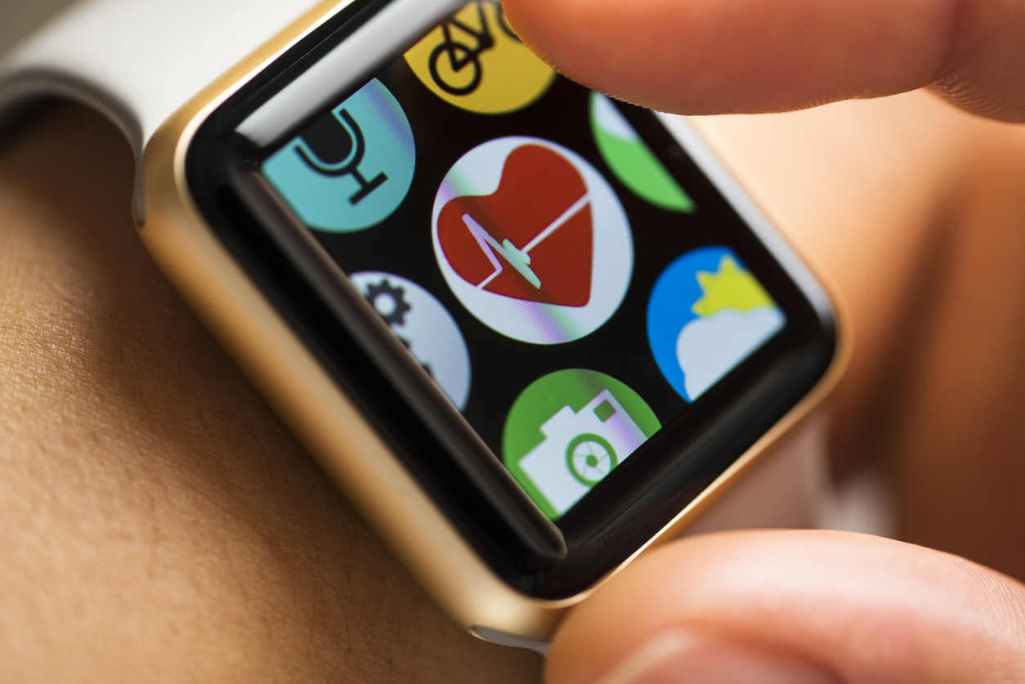
CONSUMER WEARABLE DEVICES
Benefits | Apple Heart Study
KEY FINDINGS
Low probability of receiving an irregular pulse notification
Among notifications, 84% were concordant with atrial fibrillation
STUDY DETAILS
  Participants: 419,297
  Duration: 8 months, median of 117 days of monitoring
  Irregular pulse notification yield: 2161 participants (0.52%)
Perez MV, Mahaffey KW, Hedlin H, et al. Large-Scale assessment of a smartwatch to identify atrial fibrillation. New England Journal of Medicine. 2019;381(20):1909-1917. doi:10.1056/nejmoa1901183

Slide 69
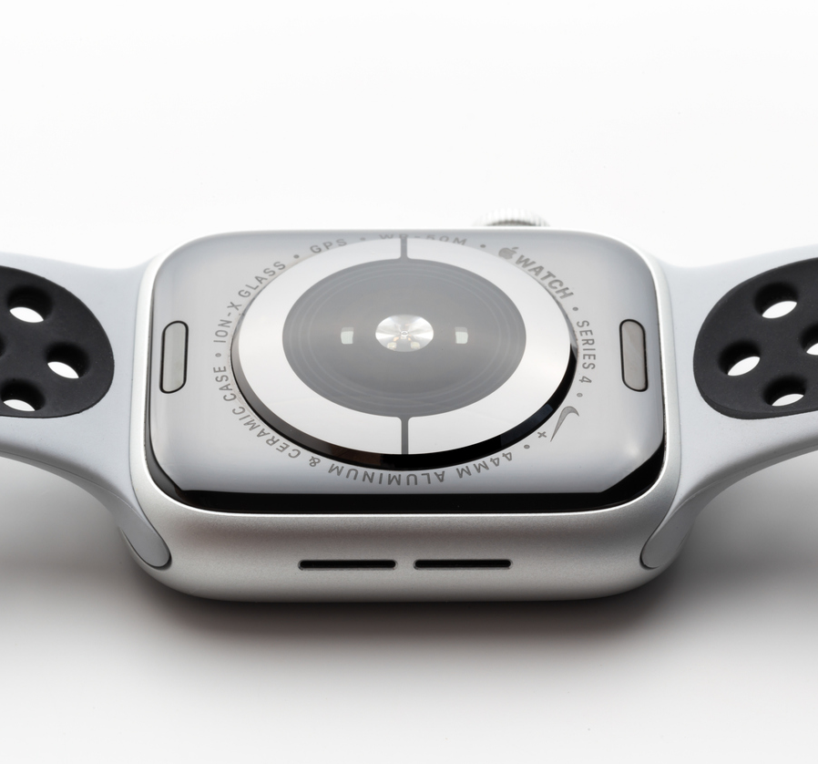
CONSUMER WEARABLE DEVICES
Passive (PPG) Monitoring
PPG measures light reflected from tissue
  Volume of arterial blood
  Increase/decrease per heartbeat
  Positive Predictive Value (PPV): 84%
Advantages:
  Widely accepted resting HR
  Great for detecting asymptomatic AF
  Low cost
Charlton PH, Kyriacou PA, Mant J, Marozas V, Chowienczyk P, Alastruey J. Wearable photoplethysmography for cardiovascular monitoring. Proceedings of the IEEE. 2022;110(3):355-381. doi:10.1109/jproc.2022.3149785
Dagher L, Shi H, Zhao Y, Marrouche NF. Wearables in cardiology: Here to stay. Heart Rhythm. 2020;17(5):889-895. doi:10.1016/j.hrthm.2020.02.023

Slide 70
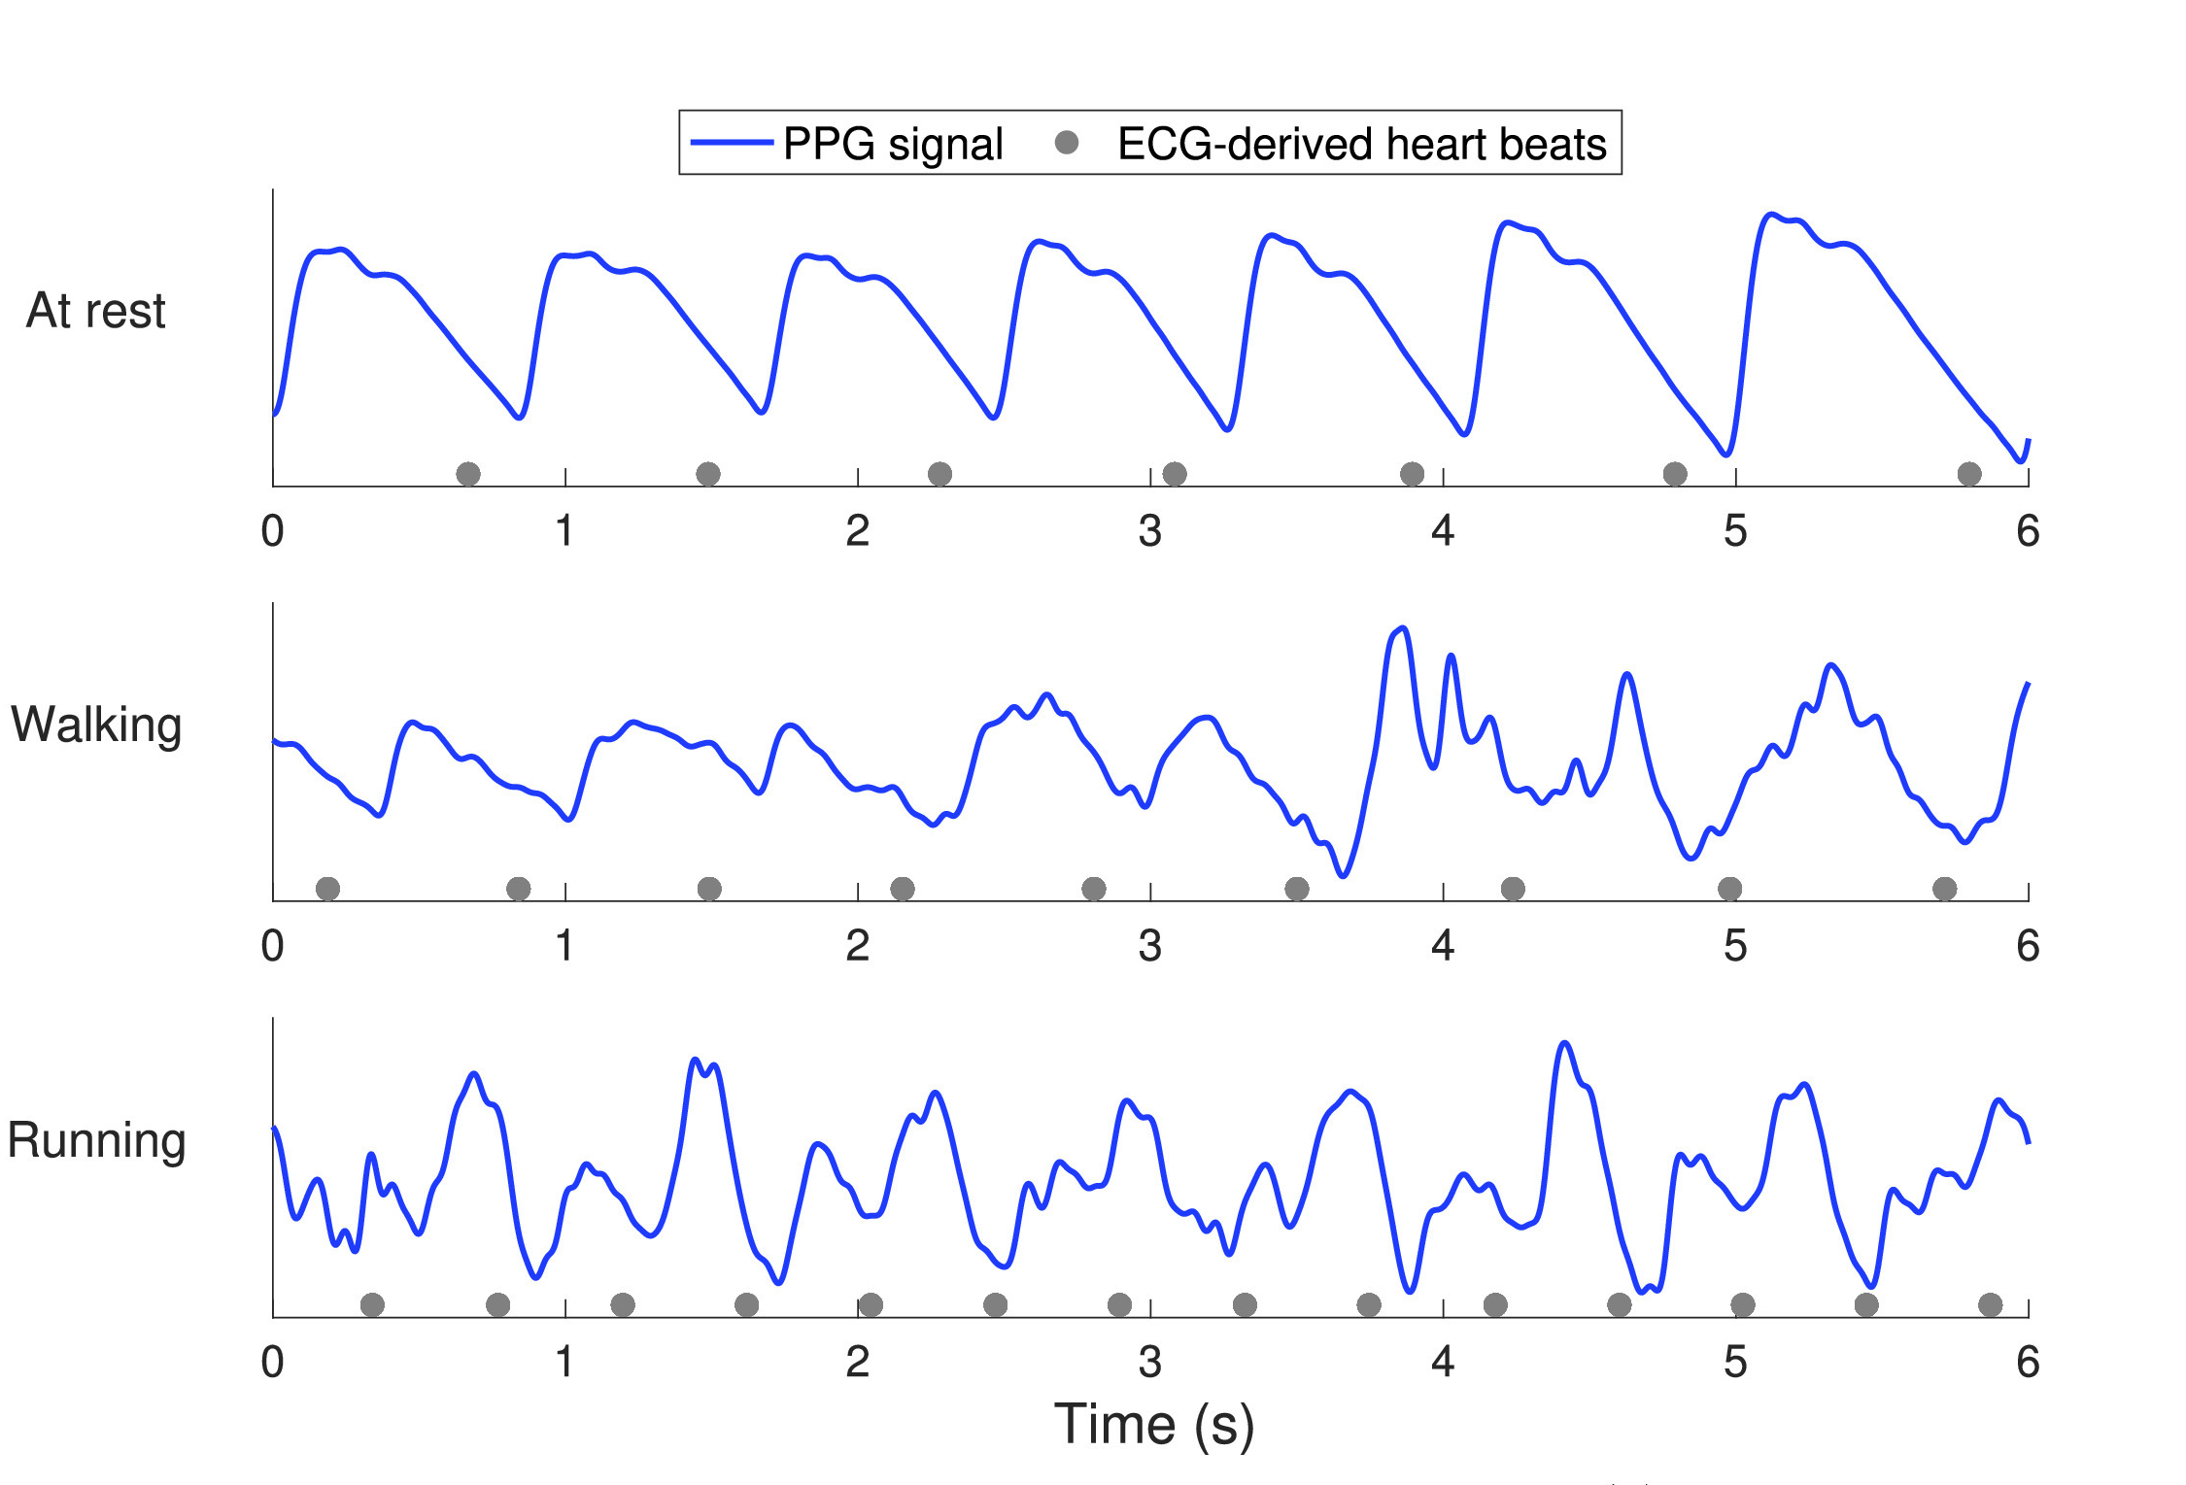
Passive (PPG) Watch-Based PPG | Limitations
CONSUMER WEARABLE DEVICES
Highly Sensitive to:
  Artifact from movement
  Peripheral vasoconstriction
Not As Effective for:
  Darker skin tones
  Detecting non-AF arrhythmias
Charlton PH, Kyriacou PA, Mant J, Marozas V, Chowienczyk P, Alastruey J. Wearable photoplethysmography for cardiovascular monitoring. Proceedings of the IEEE. 2022;110(3):355-381. doi:10.1109/jproc.2022.3149785

Slide 71
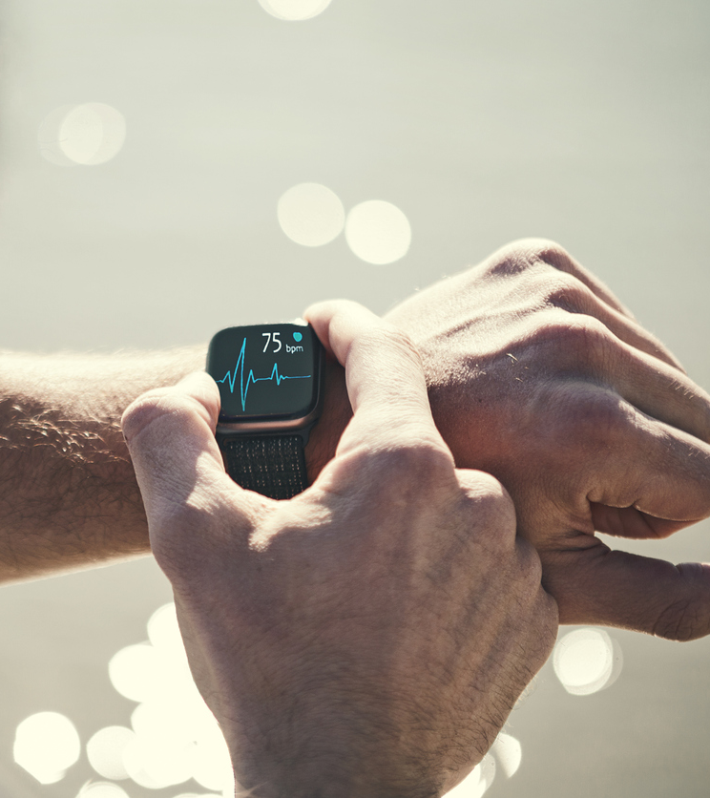
CONSUMER WEARABLE DEVICES
Active ECG Monitoring
Single lead ECG measurement
  96.6%-100% sensitivity
  94.1%-97% specificity for AF detection
Advantages:
  Validation of PPG AF alerts
  Longer term monitoring
Charlton PH, Kyriacou PA, Mant J, Marozas V, Chowienczyk P, Alastruey J. Wearable photoplethysmography for cardiovascular monitoring. Proceedings of the IEEE. 2022;110(3):355-381. doi:10.1109/jproc.2022.3149785
Dagher L, Shi H, Zhao Y, Marrouche NF. Wearables in cardiology: Here to stay. Heart Rhythm. 2020;17(5):889-895. doi:10.1016/j.hrthm.2020.02.023

Slide 72
Watch-Based ECG | Limitations
CONSUMER WEARABLE DEVICES
Tracings Labeled Inconclusive by Algorithm
Basel Heart Study
  201 patients, 31% with AF
  Manual review is required in ~25% of cases
  Cardiologist determined rhythm in 99% of cases
Convenient, but:
  Requires tech literate patients
  Potential for over-screening
  Increased staff burden
  Higher-cost technology
30%
24%
25%
25%
21%
20%
18%
17%
15%
10%
5%
0%
Apple
Samsung
Fitbit
Withings
Kardia
Mannhart D, Lischer M, Knecht S, et al. Clinical validation of 5 Direct-to-Consumer wearable smart devices to detect atrial fibrillation. JACC Clinical Electrophysiology. 2023;9(2):232-242. doi:10.1016/j.jacep.2022.09.011

Slide 73

CONSUMER WEARABLE DEVICES
Active and Passive Watch-Based Considerations
Use with Caution:
  FDA restrictions often not followed
  High number of false positives lead to healthcare overutilization and anxiety
  Alerts lead to only 11.4% of patients with a clinically actionable arrhythmia (4.9% AF)
Conclusion: Wearables are not diagnostic tools but can assist early detection
Wyatt KD, Poole LR, Mullan AF, Kopecky SL, Heaton HA. Clinical evaluation and diagnostic yield following evaluation of abnormal pulse detected using Apple Watch. Journal of the American Medical Informatics Association. 2020;27(9):1359-1363. doi:10.1093/jamia/ocaa137

Slide 74


CONSUMER WEARABLE DEVICES
Health Anxiety
and Misuse
CASE STUDY
1 in 5 AFib patients who used wearables experienced intense fear and anxiety in response to irregular rhythm notifications from their device
CONCLUSION
Wearables have potential to monitor and manage AFib, but misuse can lead to health anxiety and misuse of health resources.
Mayo Clin Proc Digit Health. 2023 Sep; 1(3): 413–418. doi: 10.1016/j.mcpdig.2023.06.014
Rosman L, Lampert R, Zhuo S, et al. Wearable devices, Health care use, and Psychological Well‐Being in Patients with Atrial Fibrillation. Journal of the American Heart Association. 2024;13(15). doi:10.1161/jaha.123.033750

Slide 75
ABCD Guide for Clinicians
CONSUMER WEARABLE DEVICES
 | Topics | Questions clinicians need to ask | Examples of how to answer these questions (based on an ECG smartwatch)
A | Assess the device Assess the literature Assess regulatory approvals Assess price Assess best practice guidelines for the use of these devices | What data (raw or processed) is generated by the device and what is its clinical utility? Are the hardware sensors accurate and clinically valid? Are the software algorithms accurate and clinically valid? What is the price of the device? Is the device FDA or CE approved for its specific indication? Is clinical evidence available to support the use of the device for a specific clinical application? | This device generates heart rate, physical activity and single-lead ECG data; the hardware has been clinically validated and FDA cleared; single-lead ECG has limitations compared with 12-lead ECGs such as the inability to diagnose acute coronary syndromes; the software algorithms for AF detection have been validated in some of the devices^{19,53}; regulatory approval or clearance status can be found on each regulatory agency’s website or in press releases; no randomized clinical trials are available showing that ECG smartwatches improve outcomes; some trials, such as HEARTLINE⁵⁴, are currently ongoing
B | Benefit to patients Benefit to clinical practice | Does the device help me with the patient’s clinical care or saves them money or inconvenience through remote monitoring? Does the device assist me with patient care by facilitating remote patient management and improving my clinical workflow and cost-effectiveness? | ECG-based devices can help me manage patients with established AF remotely, thereby improving convenience and reducing costs; I can use the device to assess AF burden in my patients; I might be able to use the device to manage anticoagulation if future trials show benefit; seeing stable patients with AF remotely while reviewing their recorded ECGs allows me to fit new patient consults within my schedule
C | Clinical workflow integration | What are the logistics of integrating the device in my clinic, such as consent or electronic health record integration? Who will teach patients how to use the device and link their data with the clinic? Who will teach the other health-care staff (such as nurses or assistants) how these devices work? What are my patients’ expectations for the frequency of reviewing wearable data? How will my patients be informed of abnormal findings and who will inform them? What parameter thresholds will be set to notify me or my patients? Can I bill for the device initial setup? Can I bill for reviewing the data? What data can I bill for and how frequently? What are the billing codes? | Reimbursement for virtual visits and remote monitoring requires patient consent; some smartwatches can share patient ECGs to electronic health records, for example, Apple Watch-derived ECGs can be shared to some electronic health records such as EPIC; if a patient has a smartwatch ECG, my trained assistant or myself will teach them how to acquire and transmit an ECG; I might invest in buying a model smartwatch for demonstration to my staff or medical trainees; if the patient records an ECG for a new episode, they will share the ECG with me through the electronic medical records and will notify my assistant about the episode; otherwise, we will review regularly acquired ECGs during our in-person or virtual visits; future software platforms might allow the clinician to set customizable alarms (for example, alert me if more than five episodes of AF per month or when episodes of rapid ventricular response occur); discuss with my billing department the codes that can be used to bill for remote monitoring set up and data review (for example, in the USA, CPT codes 99453, 99454, 99457 and 99091 can be used)¹¹⁵
D | Data rights and governance Data storage and privacy | Who owns the rights to the data? Can I use these data for research? Do I have data user agreements or privacy policies in place? Can I send these data to a third party and how does this affect patient care and trust? Where are these data being stored and are they HIPAA secured? | The patient must consent to the rights for using their data in research or sharing the data with third parties; the wearable ECG devices will be only accessible through HIPAA-compliant electronic medical records; the patient should be aware that cybersecurity breaches are a possibility, especially if non-secure platforms are used
Bayoumy K, Gaber M, Elshafeey A, et al. Smart wearable devices in cardiovascular care: where we are and how to move forward. Nature Reviews Cardiology. 2021;18(8):581-599. doi:10.1038/s41569-021-00522-7

Slide 76
Developing Best Practices
CONSUMER WEARABLE DEVICES
Atrial fibrillation detected?
No
Yes
Pretest probability
of atrial fibrillation
Medical-grade cardiac monitoring
Negative
High
Low
Increase monitoring durations
Positive
Atrial fibrillation unlikely
Atrial fibrillation ruled in
Negative
Positive
Mohamoud A, Jensen J, Buda KG. Consumer-grade wearable cardiac monitors: What they do well, and what needs work. Cleveland Clinic Journal of Medicine. 2024;91(1):23-29. doi:10.3949/ccjm.91a.23030

Slide 77
Conclusions
CONSUMER WEARABLE DEVICES
  Smart watches have proven to be invaluable for diagnosing AF
  Proactively incorporate a smart watch strategy in your clinic to:
    Help reduce staff burden
    Identify patients who would benefit by a prescribable monitor
  Many clinical trials are ongoing to help understand application and utility
  Multi-sensor consumer-based AI technologies are only going to increase
DATA URGENCY
Wearables
SYMPTOM FREQUENCY
MONITORING DURATION
Disclaimer: Ambulatory monitoring devices are intended for use in routine, non-acute settings and are not designed for high-risk patients or those requiring continuous, intensive care.

Slide 78
Conclusions
CONSUMER WEARABLE DEVICES
Mobile Cardiac
Telemetry
DURING WEAR
MONITORING
DATA URGENCY
Implantable Loop Recorder
Long-Term Continuous
Monitor
Event Recorder
RETROSPECTIVE
MONITORING
Wearables
Holter Monitor
SYMPTOM FREQUENCY
MONITORING DURATION
Disclaimer: Ambulatory monitoring devices are intended for use in routine, non-acute settings and are not designed for high-risk patients or those requiring continuous, intensive care.

Slide 79
Questions?
CEM0008.01

Slide 80
Thank you!
  Contact Info Here
  (As desired)
CEM0008.01

